Slide 1

Secure Software Engineering
Chapter 1: Introduction to Secure Software Engineering
Dr. Mohammed Tawfik
1

Slide 2





What is Secure Software Engineering?
Definition
Secure Software Engineering is the practice of designing,
building, and maintaining software systems that remain
dependable in the face of malicious attacks and unexpected
events.
Importance
Critical in today's interconnected world where software
vulnerabilities can lead to significant financial losses, data
breaches, and reputation damage.
Course Overview
This course covers secure development methodologies,
threat modeling, secure coding practices, and security testing
throughout the software development lifecycle.
2

Slide 3

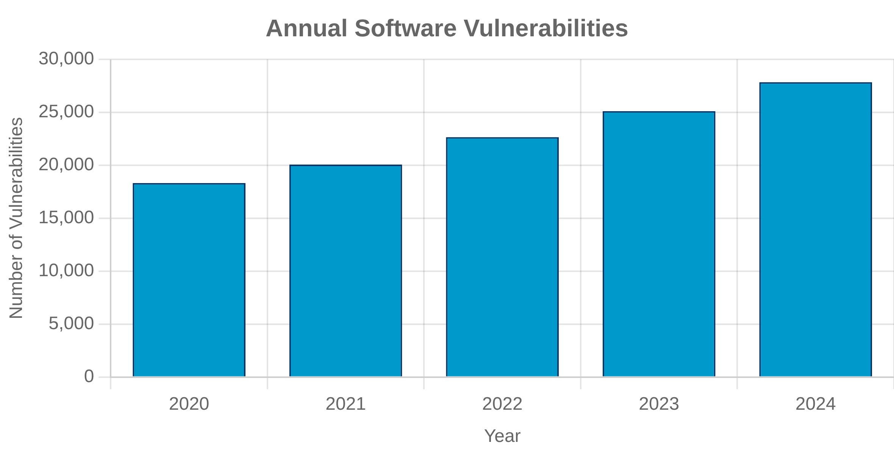



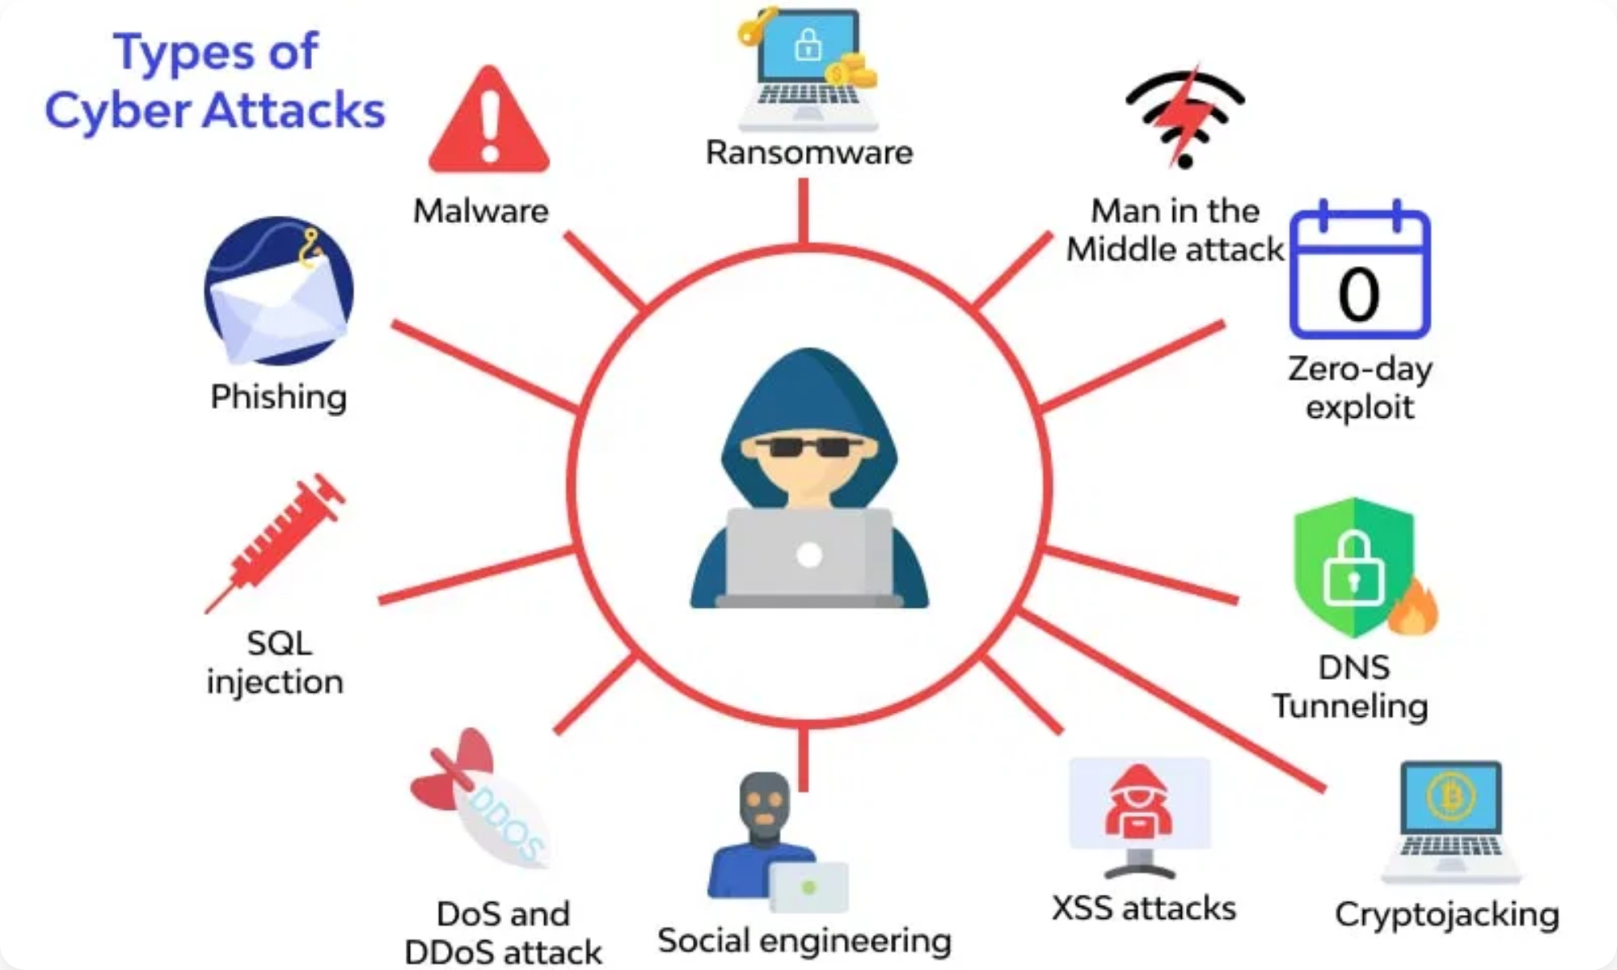

The Need for Secure Software
Vulnerability Statistics
Over 20,000 new software vulnerabilities are discovered
annually, with a 38% increase in the last five years.
Real-world Examples
Equifax (2017): 147 million people affected by a breach due
to unpatched software vulnerability.
SolarWinds (2020): Supply chain attack affected 18,000
organizations including government agencies.
Consequences
Average cost of a data breach in 2024: $4.45 billion, with
regulated industries facing even higher costs.
3

Slide 4

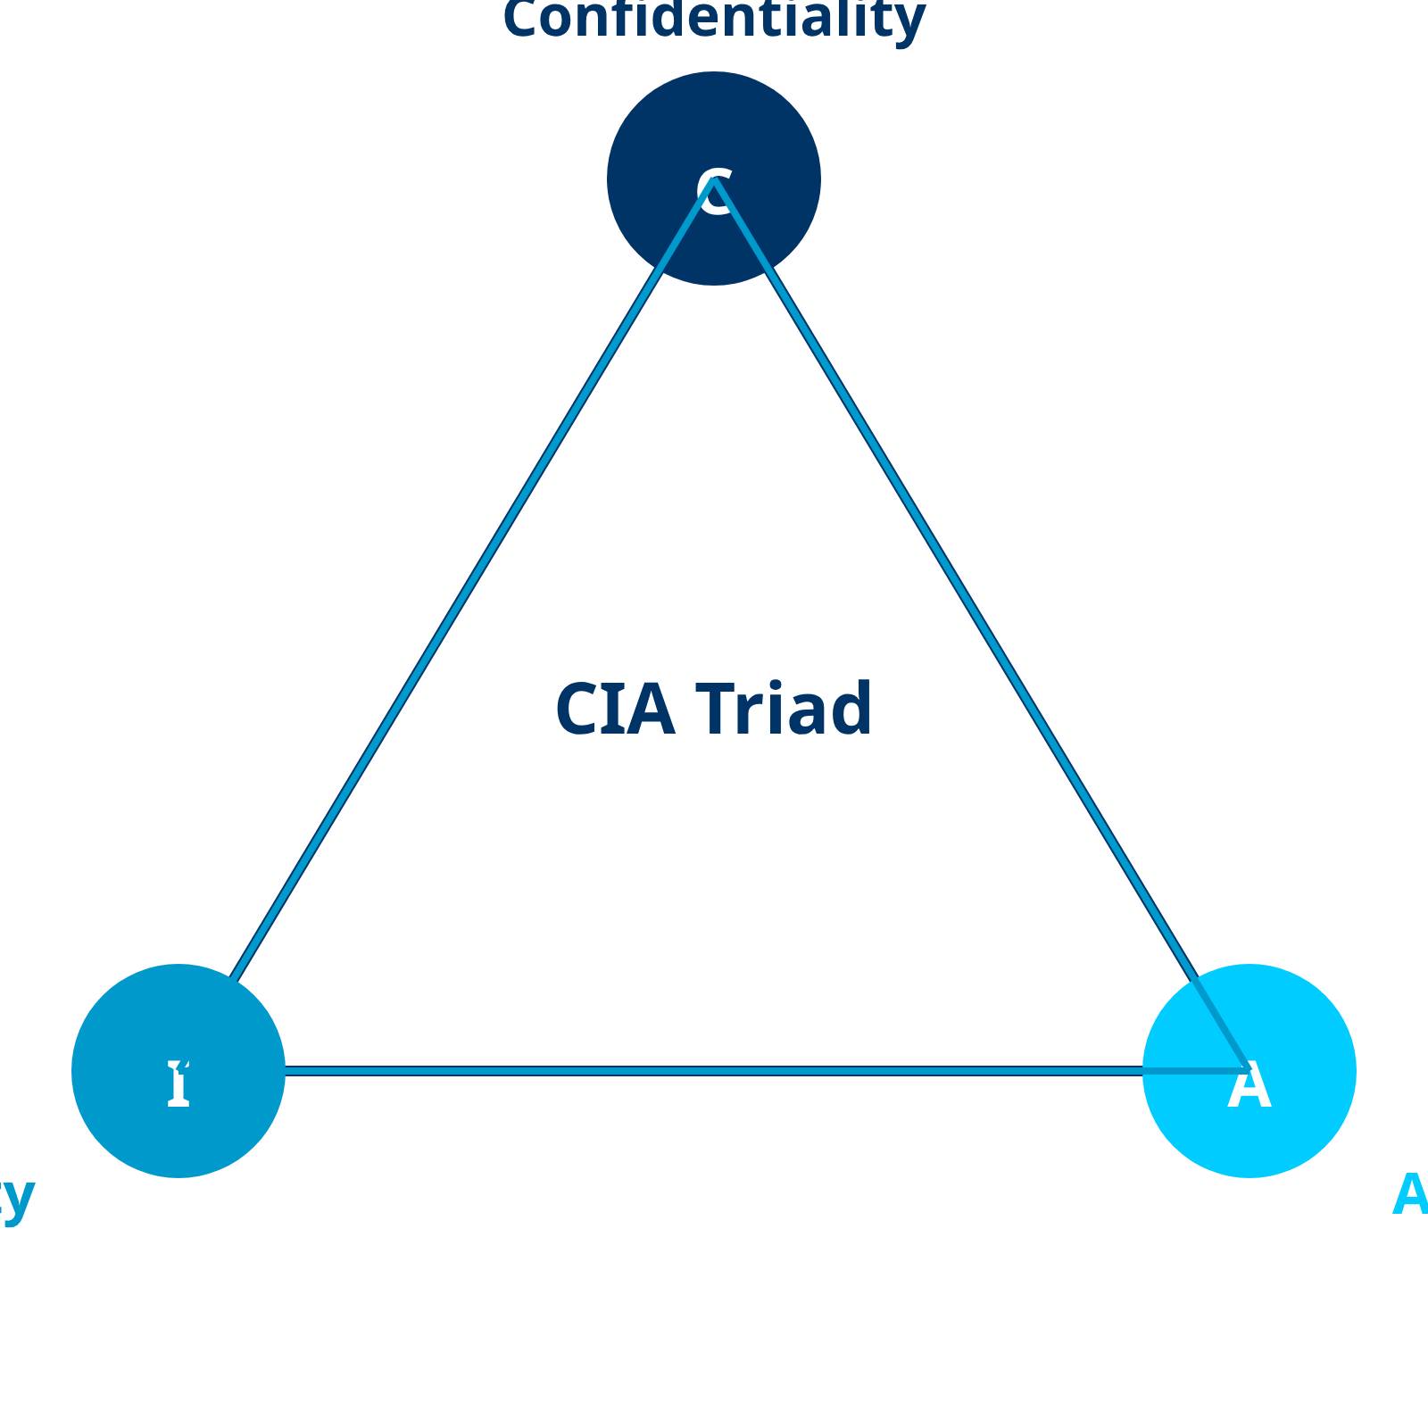




Core Principles of SSE
CIA Triad
Confidentiality:
Ensuring information is accessible only to
those authorized to have access.
Integrity:
Maintaining and assuring the accuracy and
completeness of data over its entire lifecycle.
Availability:
Ensuring information is accessible to
authorized users when needed.
Threat Modeling
Systematic approach to identify potential threats,
vulnerabilities, and attack vectors in a system.
Risk Management
Process of identifying, assessing, and controlling threats
to an organization's capital and earnings.
4

Slide 5
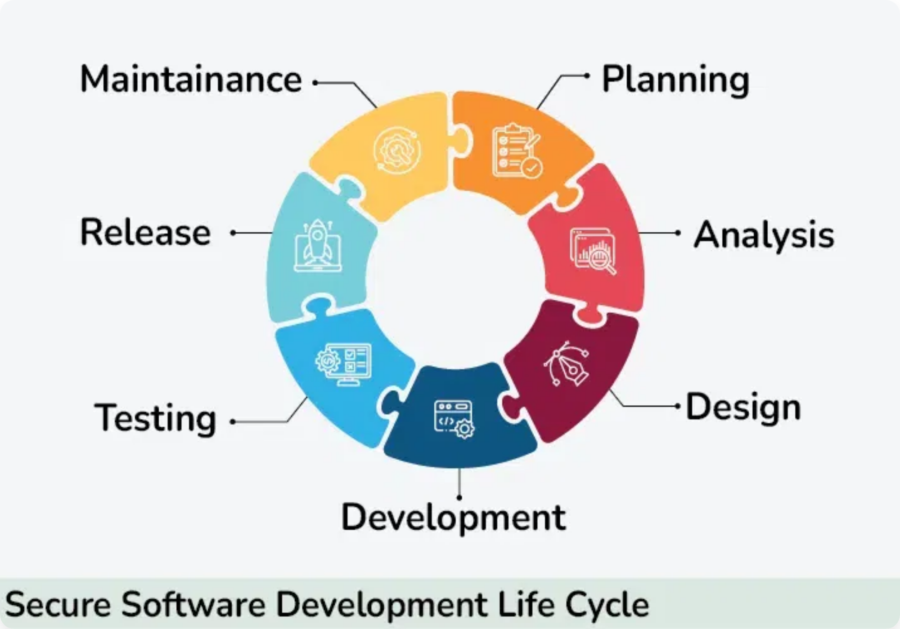


Secure Software Development Lifecycle (SSDLC)
What is SSDLC?
A process that integrates security activities throughout
each phase of the traditional software development lifecycle.
Comparison with Traditional SDLC
While traditional SDLC focuses on functionality and
performance, SSDLC adds security considerations at every
stage.
Key Phases of SSDLC
1. Requirements: Security requirements gathering
2. Design: Threat modeling and secure architecture
3. Implementation: Secure coding practices
4. Testing: Security testing and vulnerability assessment
5. Deployment & Maintenance: Secure configuration and
monitoring
5

Slide 6






SSDLC Phase 1: Requirements
Security Requirements Gathering
Identify and document security requirements early in the
development process, including compliance needs, data
protection, and access control.
Identify security objectives
Abuse Cases and Misuse Cases
Define scenarios where attackers might attempt to
Develop abuse/misuse cases
compromise the system, helping to identify security
requirements that might otherwise be overlooked.
Security Standards and Policies
Apply security standards
Incorporate industry standards (OWASP, NIST, ISO 27001)
and organizational security policies into requirements to
Document security requirements
ensure compliance.
6

Slide 7
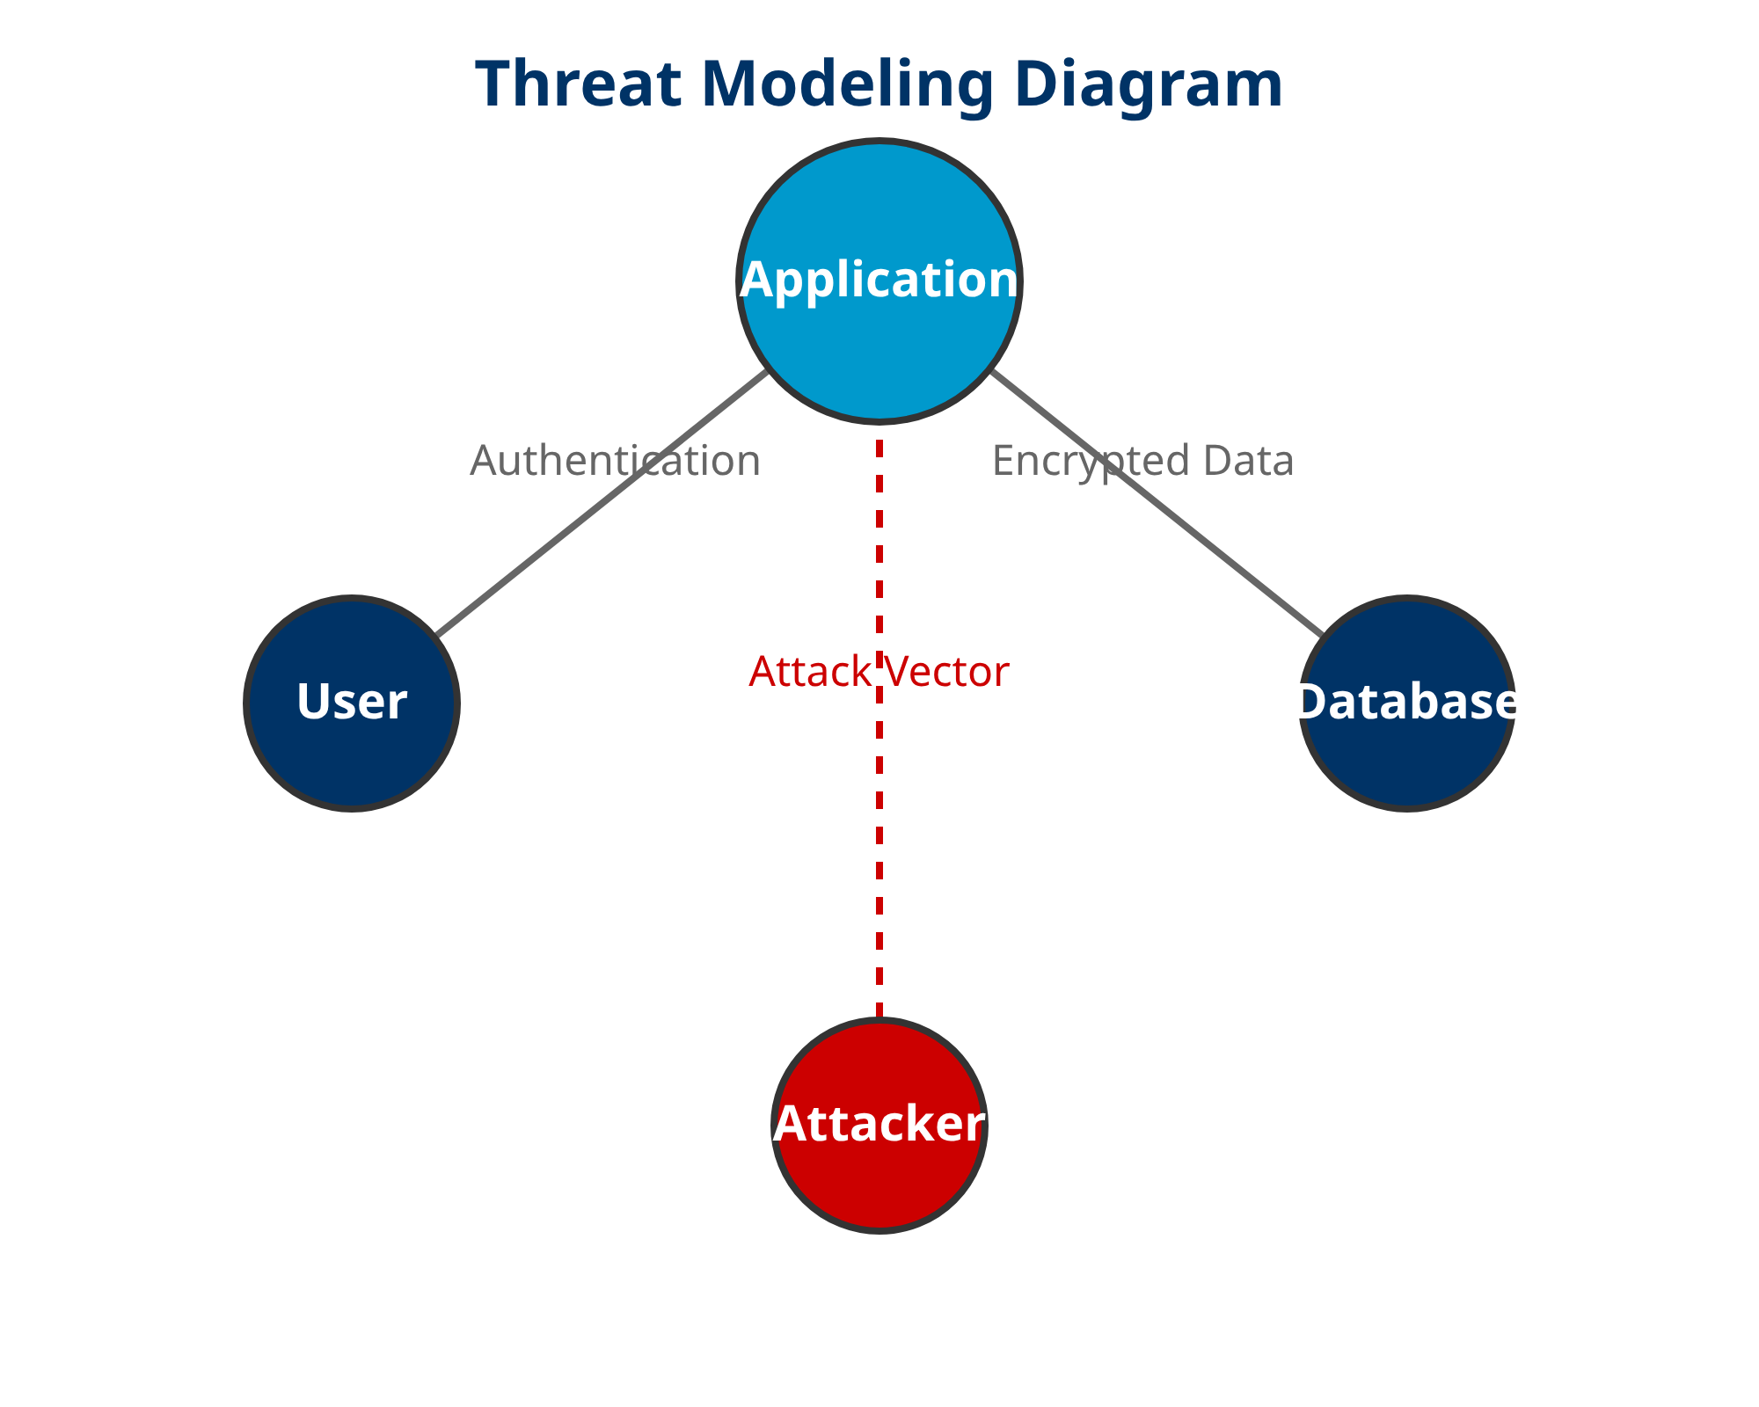


SSDLC Phase 2: Design
Secure Design Principles
Least Privilege:
Components should have minimal access
rights needed to perform their functions.
Defense in Depth:
Multiple layers of security controls to
protect critical assets.
Threat Modeling in Design
Systematic approach to identify potential threats and
vulnerabilities before implementation.
Secure Design Patterns
Reusable solutions to common security design problems
(e.g., Secure Factory, Secure Proxy, Secure Broker).
7

Slide 8

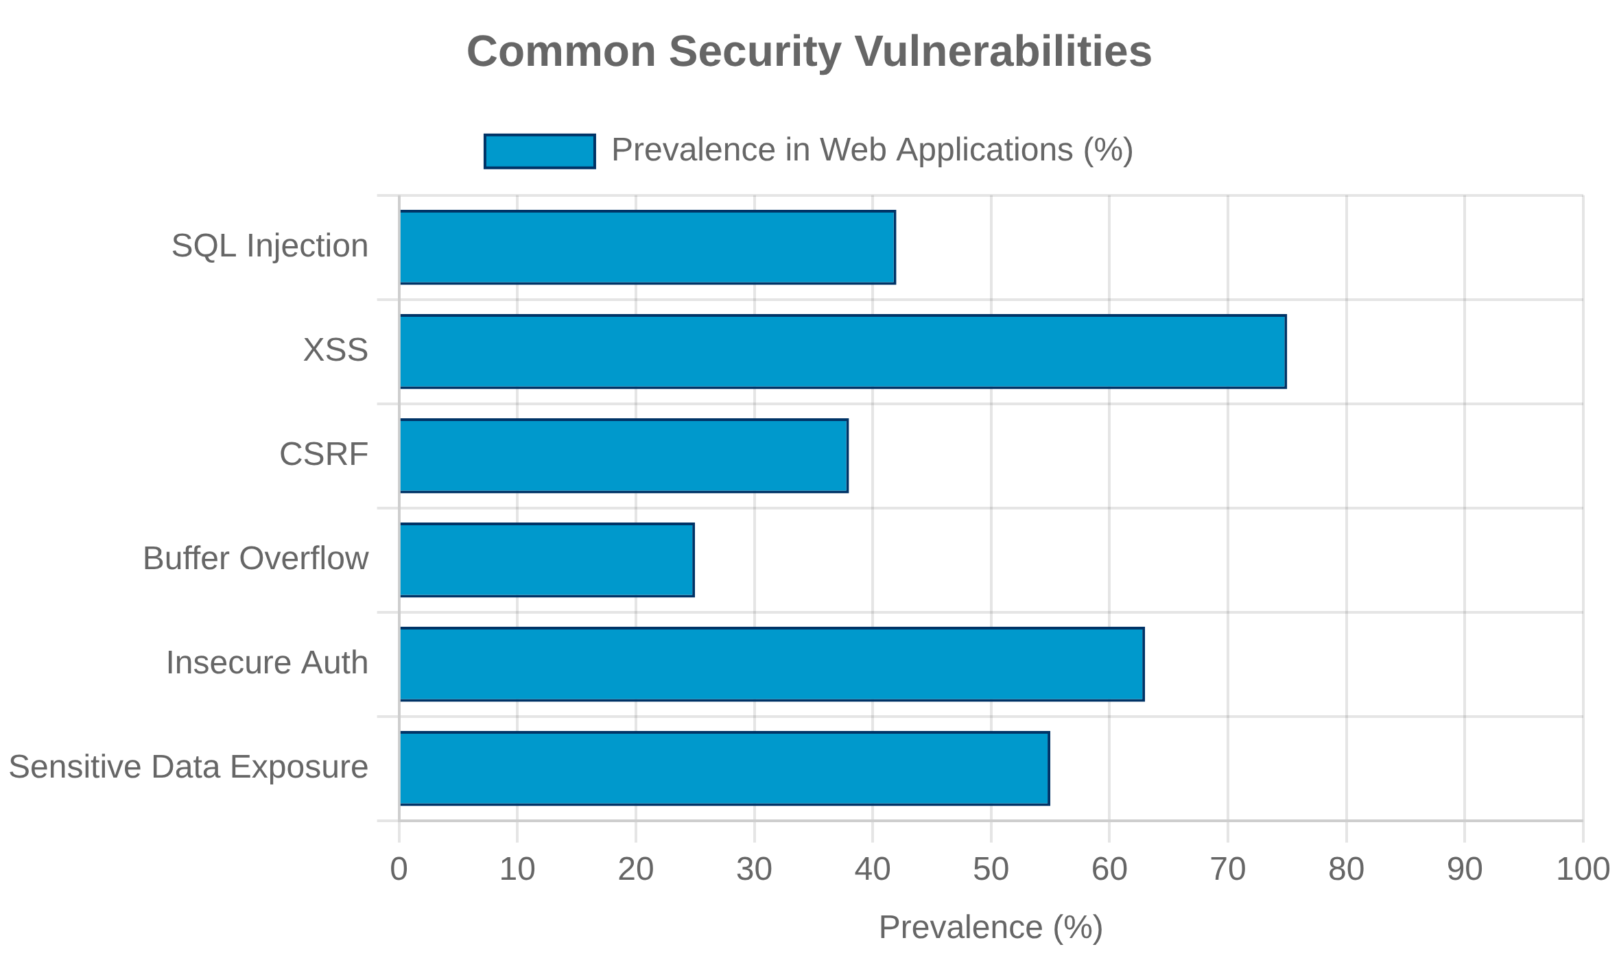



SSDLC Phase 3: Implementation
Secure Coding Practices
Input validation, output encoding, parameterized queries,
and proper error handling
Common Vulnerabilities
SQL injection, Cross-Site Scripting (XSS), Cross-Site Request
Forgery (CSRF), and buffer overflows
Code Analysis Tools
Static Application Security Testing (SAST): Analyzes source
code without execution
Dynamic Application Security Testing (DAST): Tests running
applications for vulnerabilities
8

Slide 9

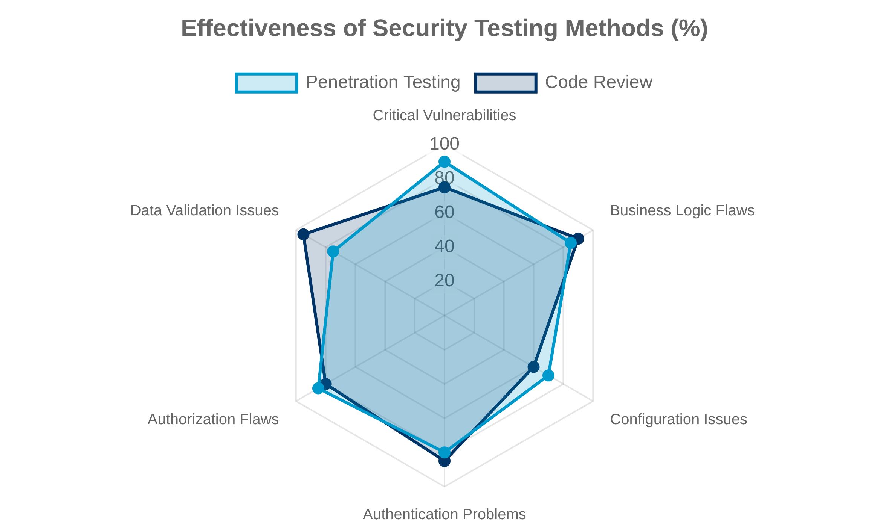



SSDLC Phase 4: Testing
Security Testing Methodologies
Penetration Testing:
Simulated attacks to identify
exploitable vulnerabilities
Fuzzing:
Automated technique that provides invalid,
unexpected inputs to find bugs
Vulnerability Assessment
Systematic review of security weaknesses in systems and
applications
Security Code Review
Manual or automated examination of source code to
identify security flaws
9

Slide 10

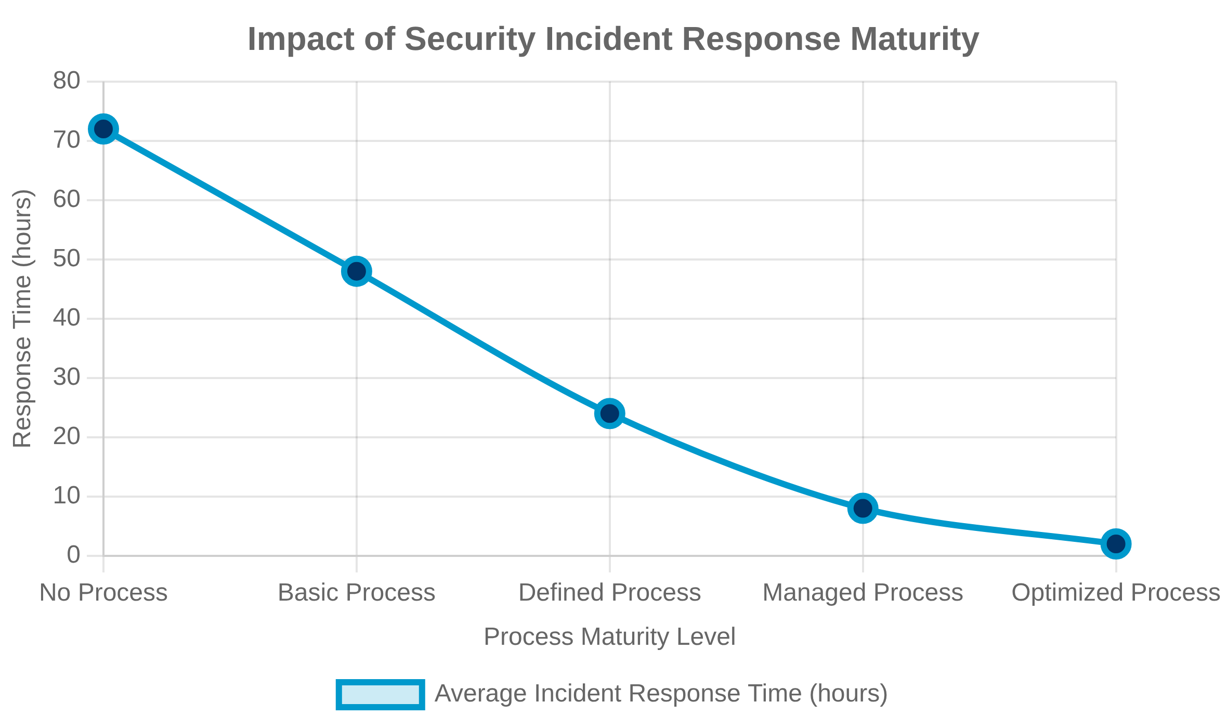


SSDLC Phase 5: Deployment and Maintenance
Secure Deployment and Configuration
Hardened server configurations, secure default settings,
and proper access controls for production environments
Incident Response and Management
Established procedures for detecting, responding to, and
recovering from security incidents
Continuous Monitoring and Patching
Regular security assessments, vulnerability scanning, and
timely application of security patches
10

Slide 11

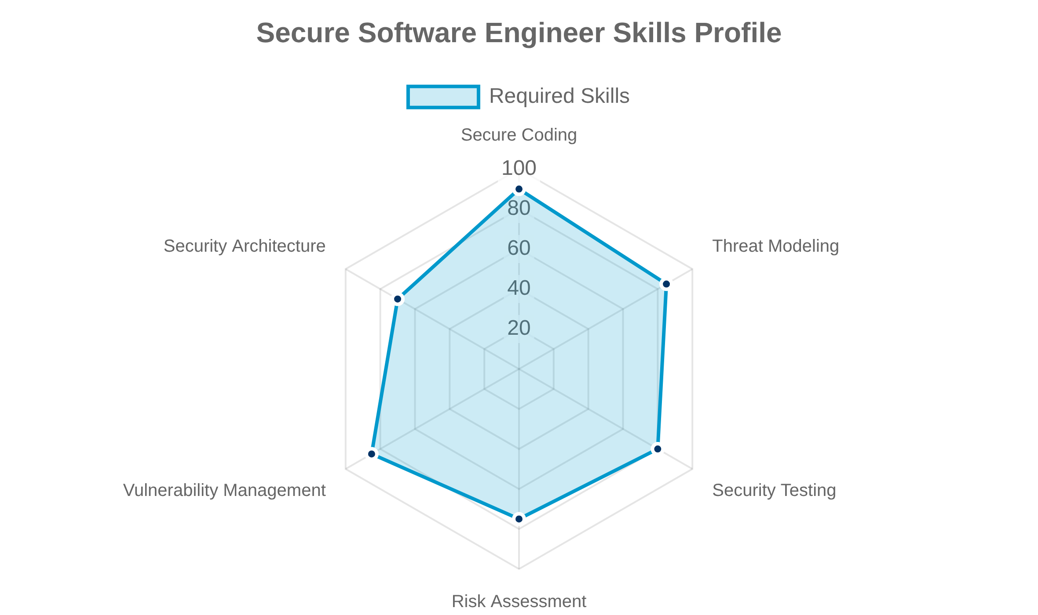


The Role of the Secure Software Engineer
Responsibilities and Skills
Implementing security controls, conducting code reviews,
performing threat modeling, and staying updated on
emerging threats and vulnerabilities.
Collaboration with Other Teams
Works closely with developers, QA testers, operations, and
security teams to ensure security is integrated throughout the
development process.
Career Paths in Software Security
Progression from Security Developer to Security Architect,
Application Security Manager, or Chief Information Security
Officer (CISO).
11

Slide 12


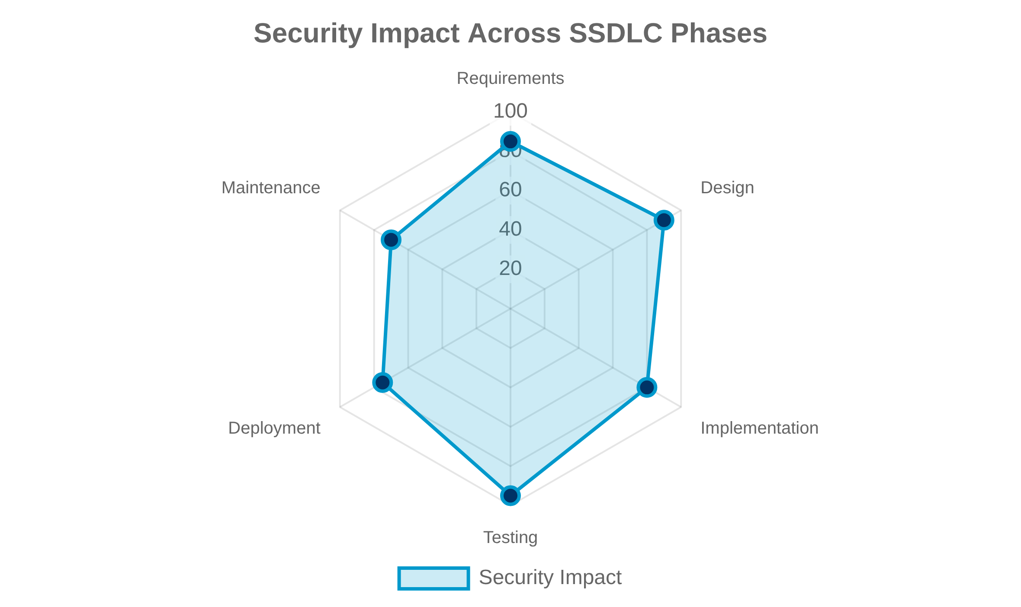


Summary and Next Steps
Key Takeaways
Security must be integrated throughout the entire
software development lifecycle, not added as an
afterthought.
The CIA triad (Confidentiality, Integrity, Availability)
forms the foundation of secure software engineering.
Each phase of the SSDLC has specific security activities
that contribute to the overall security posture.
Preview of Chapter 2
Advanced threat modeling techniques
Secure coding practices for specific languages and
frameworks
Security testing methodologies and tools
12

Slide 13

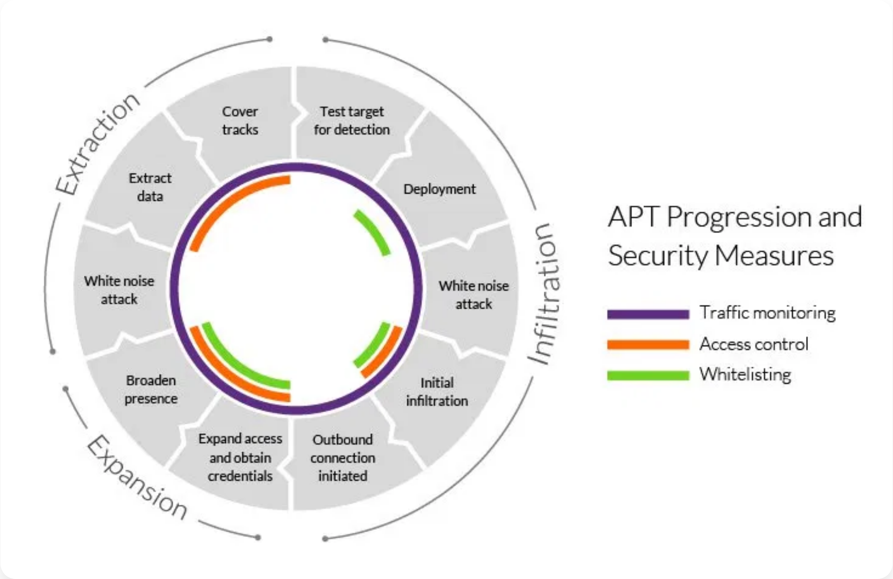

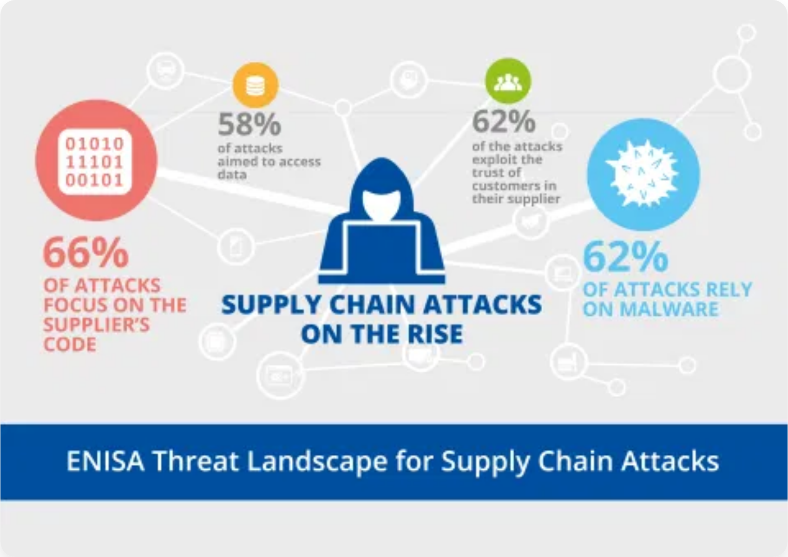


Emerging Threats in SSE
Advanced Persistent Threats (APTs)
Sophisticated, targeted attacks that persist over
extended periods to steal data or cause damage.
Supply Chain Attacks
Compromising software through its supply chain,
affecting all downstream users (e.g., SolarWinds).
AI/ML-powered Attacks
Using artificial intelligence to automate attacks, evade
detection, and exploit vulnerabilities.
IoT and Edge Security Challenges
Securing billions of connected devices with limited
resources and diverse architectures.
13

Slide 14

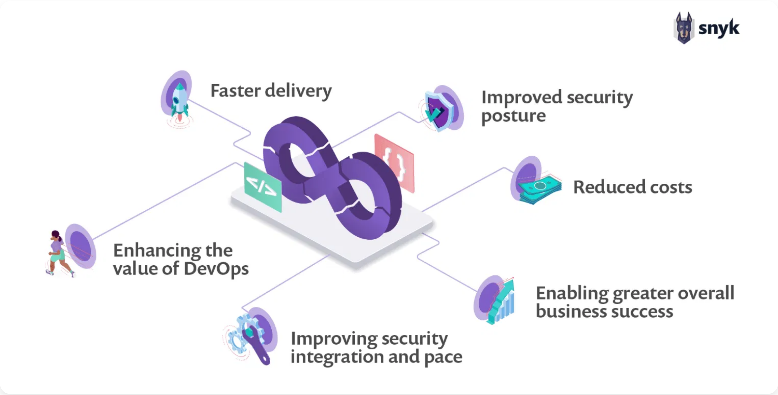
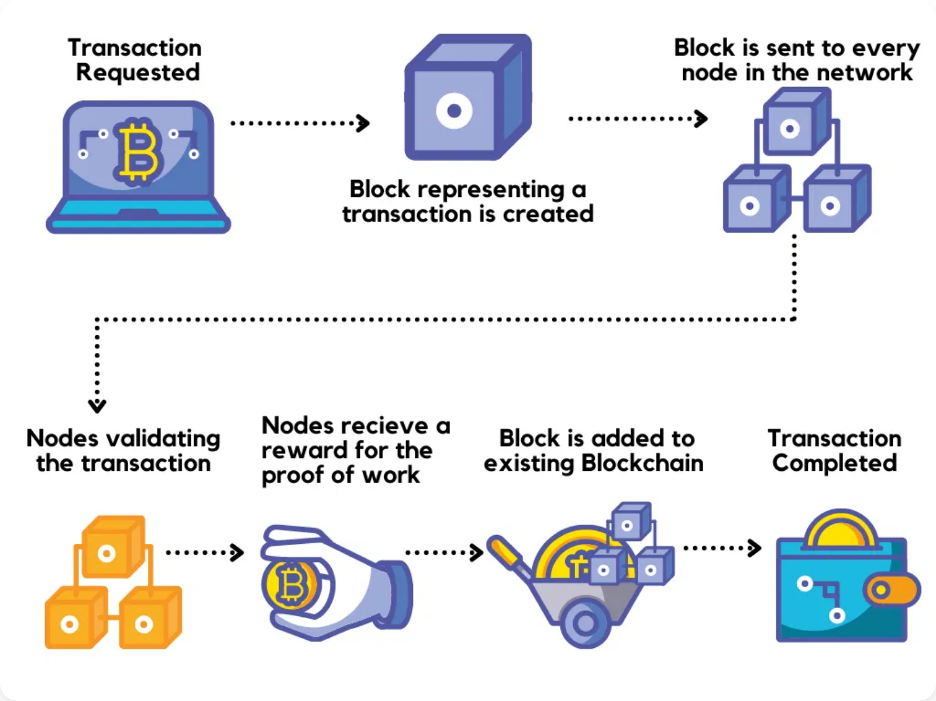
Future Trends in Secure Software Engineering
DevSecOps Integration
Embedding security throughout the development pipeline, making it a shared responsibility across teams.
Quantum-Safe Cryptography
Developing cryptographic algorithms resistant to quantum computing attacks.
Blockchain for Security
Using distributed ledger technology to enhance software integrity and supply chain security.
Human Factors in Security
Focusing on developer education, security culture, and usable security practices.
14

Slide 15

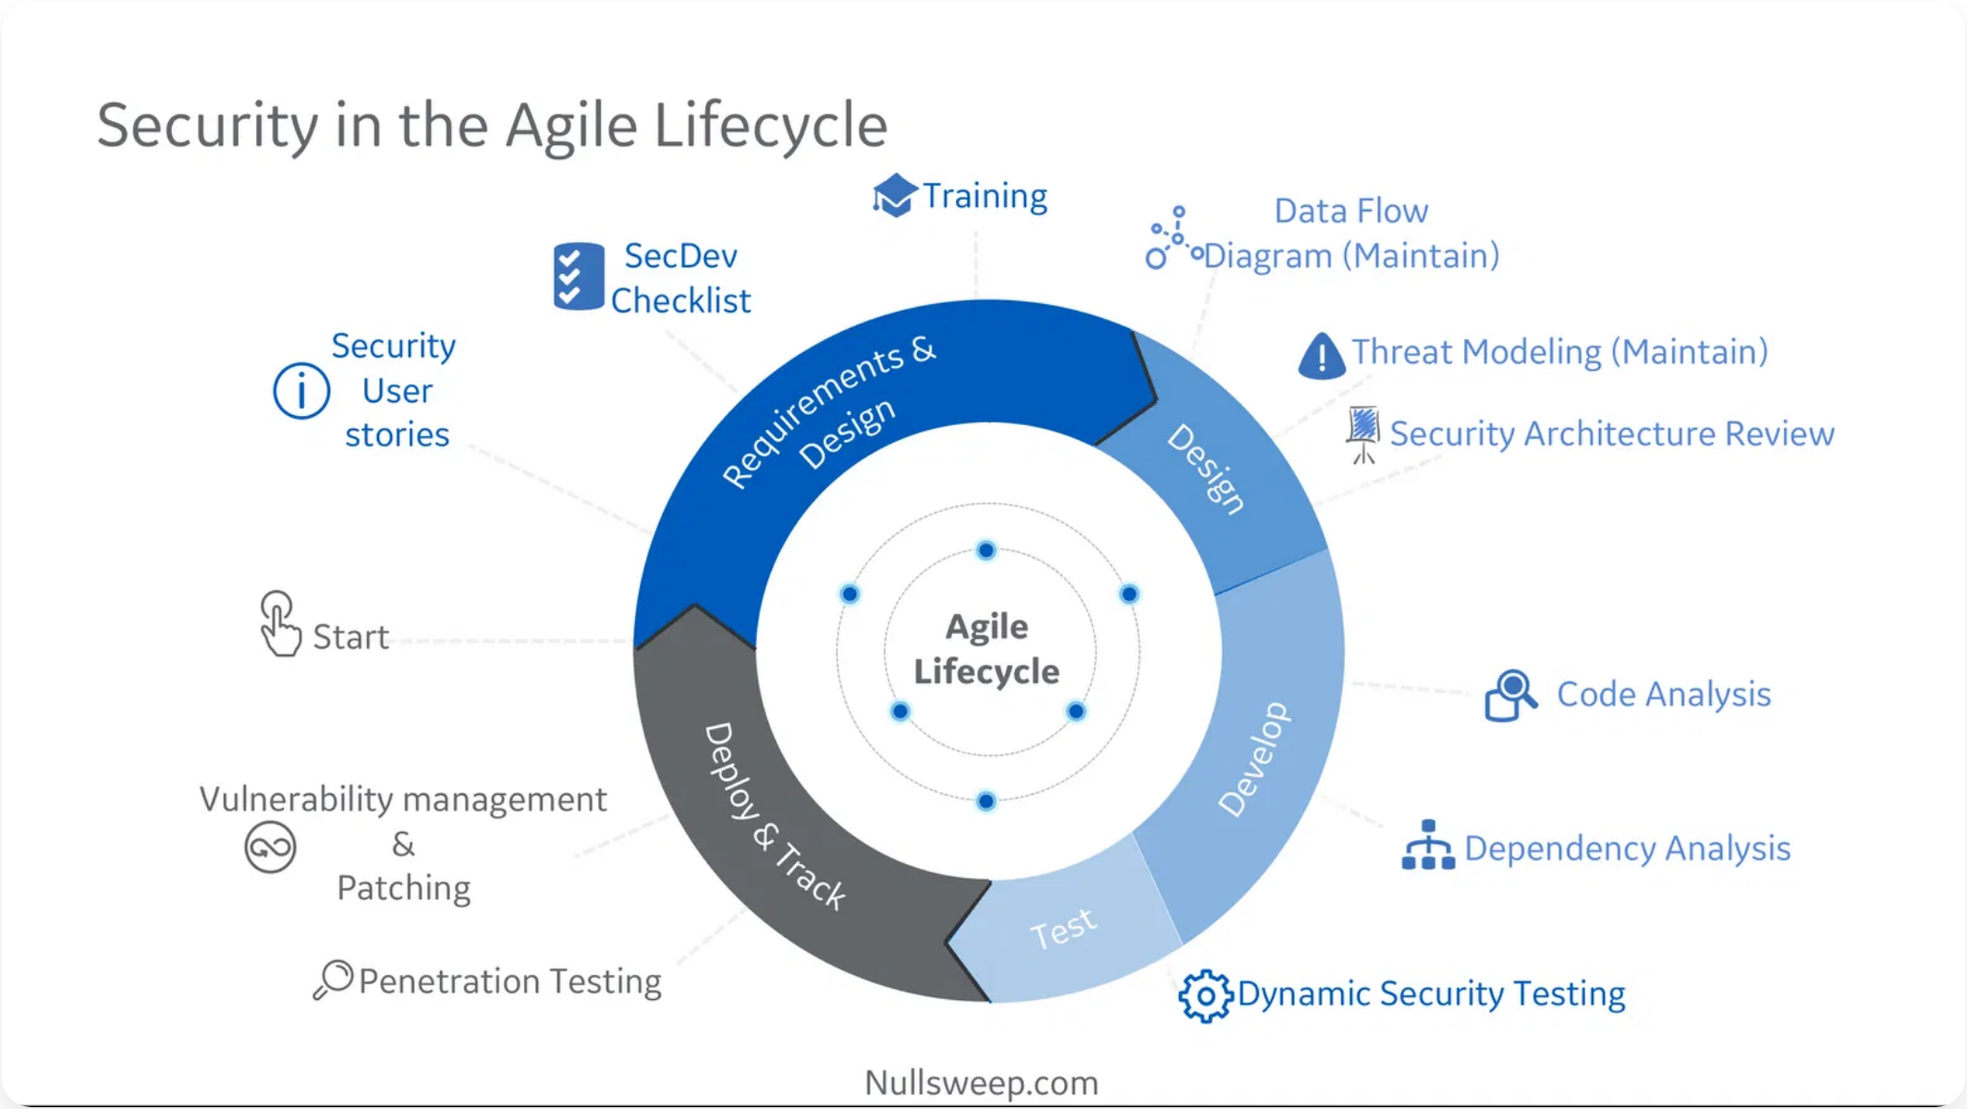


Secure Software Development Methodologies
Agile with Security Considerations
Integrating security activities into each sprint, including threat modeling, security testing, and code reviews.
Waterfall and Security Gates
Implementing security checkpoints at each phase transition, requiring security approval before proceeding.
DevOps and DevSecOps Integration
Embedding security throughout the CI/CD pipeline, automating security testing, and making security a shared responsibility.
15

Slide 16

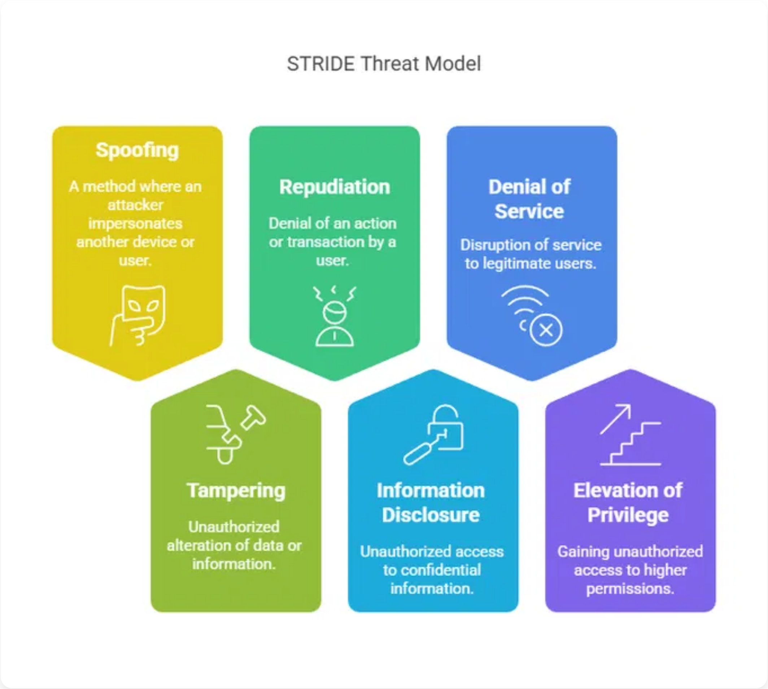


Threat Modeling Frameworks
STRIDE
Microsoft's approach focusing on six threat categories:
S
poofing,
T
ampering,
R
epudiation,
I
nformation disclosure,
D
enial of
service,
E
levation of privilege.
DREAD
Risk assessment model that quantifies threats based on:
D
amage,
R
eproducibility,
E
xploitability,
A
ffected users,
D
iscoverability.
PASTA
P
rocess for
A
ttack
S
imulation and
T
hreat
A
nalysis: A risk-centric
methodology that aligns technical security requirements with
business objectives.
16

Slide 17

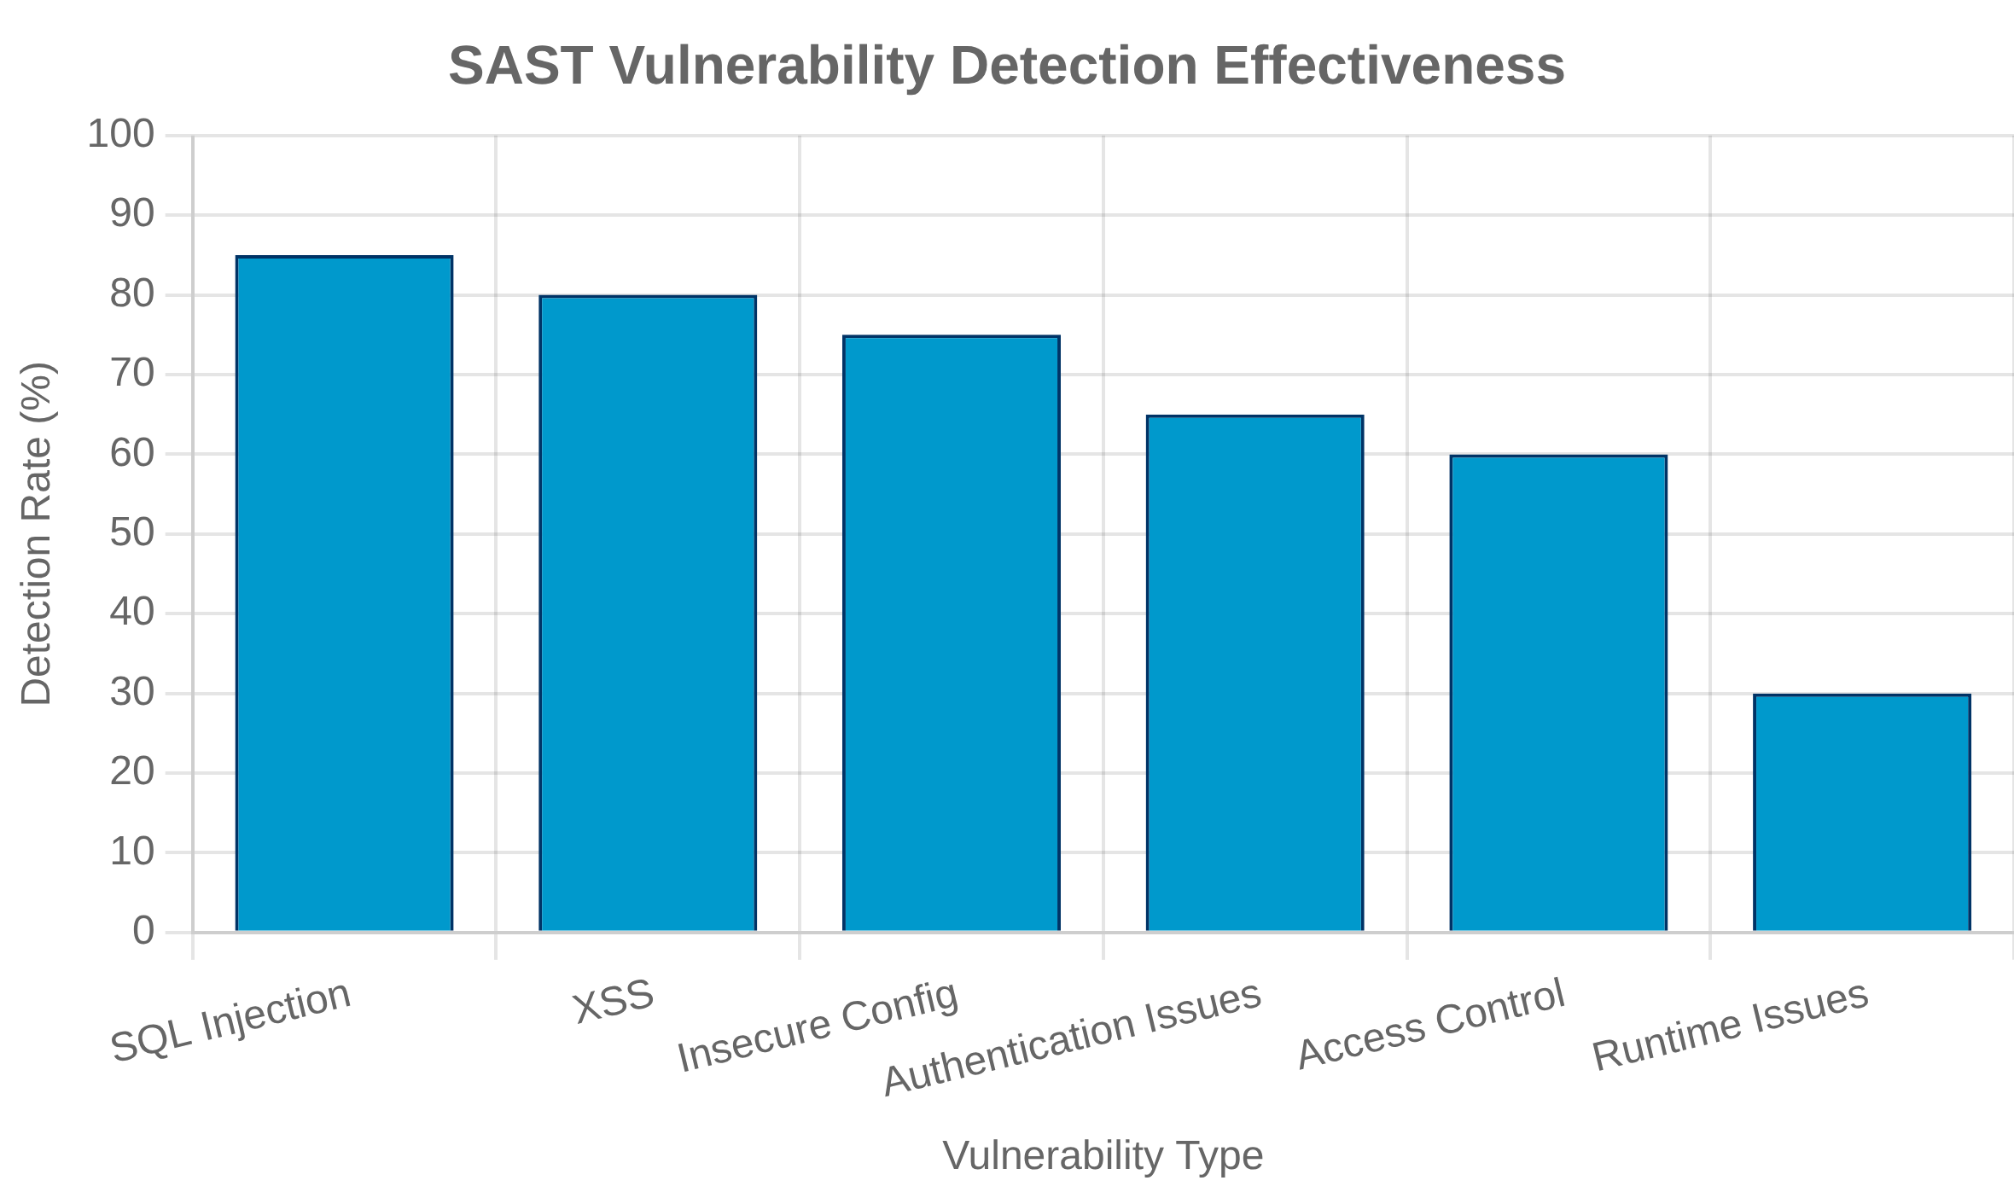





Static Application Security Testing (SAST)
What is SAST?
A white-box testing method that analyzes source code for
security vulnerabilities without executing the application.
Benefits
Early detection of vulnerabilities in the development
lifecycle
Identifies issues like SQL injection, XSS, buffer overflows,
and insecure coding practices
Limitations
Cannot detect runtime vulnerabilities or issues in third-
party components
Popular SAST Tools
SonarQube
Checkmarx
Fortify
Veracode
ESLint
17

Slide 18

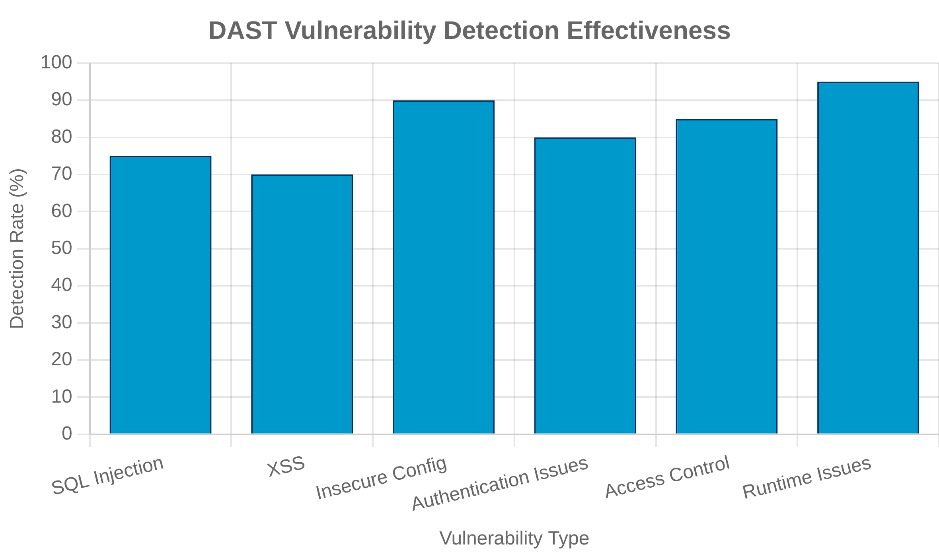


Dynamic Application Security Testing (DAST)
What is DAST?
A black-box testing method that analyzes a running
application to find vulnerabilities that can be exploited from
outside.
Benefits
Detects runtime vulnerabilities and configuration issues
Language and framework agnostic, works with any web
application
Limitations
Cannot pinpoint the exact location of vulnerabilities in the
code
Popular DAST Tools
OWASP ZAP
Burp Suite
Acunetix
Netsparker
AppScan
18

Slide 19

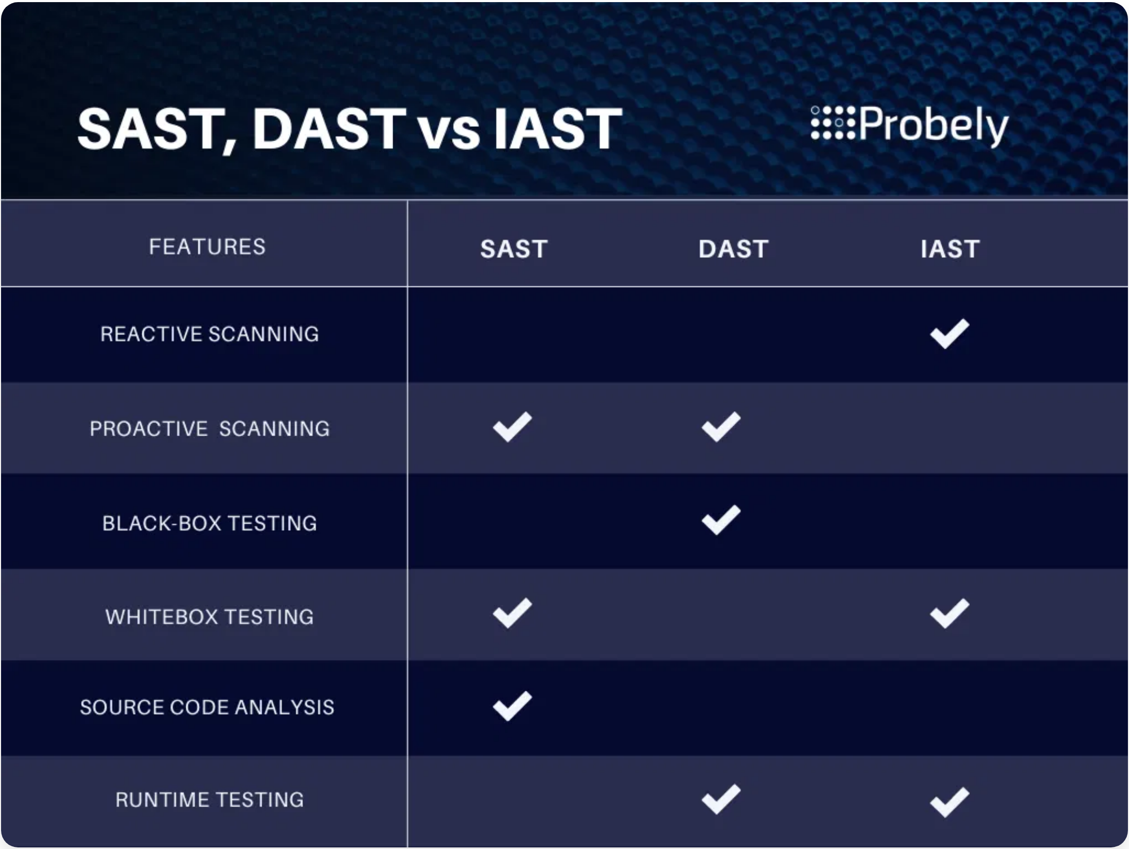

Interactive Application Security Testing (IAST) & Runtime Application Self-Protection (RASP)
IAST: Combining SAST and DAST Benefits
Analyzes code during runtime by instrumenting the
application, providing both code-level insights and runtime
vulnerability detection.
Provides accurate vulnerability location with minimal false
positives.
RASP: Protecting Applications from Within
Integrates directly with the application to detect and block
attacks in real-time.
Provides protection even when vulnerabilities exist in the
code.
Feature
IAST
RASP
Primary Purpose
Testing & Detection
Protection & Mitigation
When Used
Development & Testing
Production
Performance Impact
Moderate
Low to Moderate
19

Slide 20
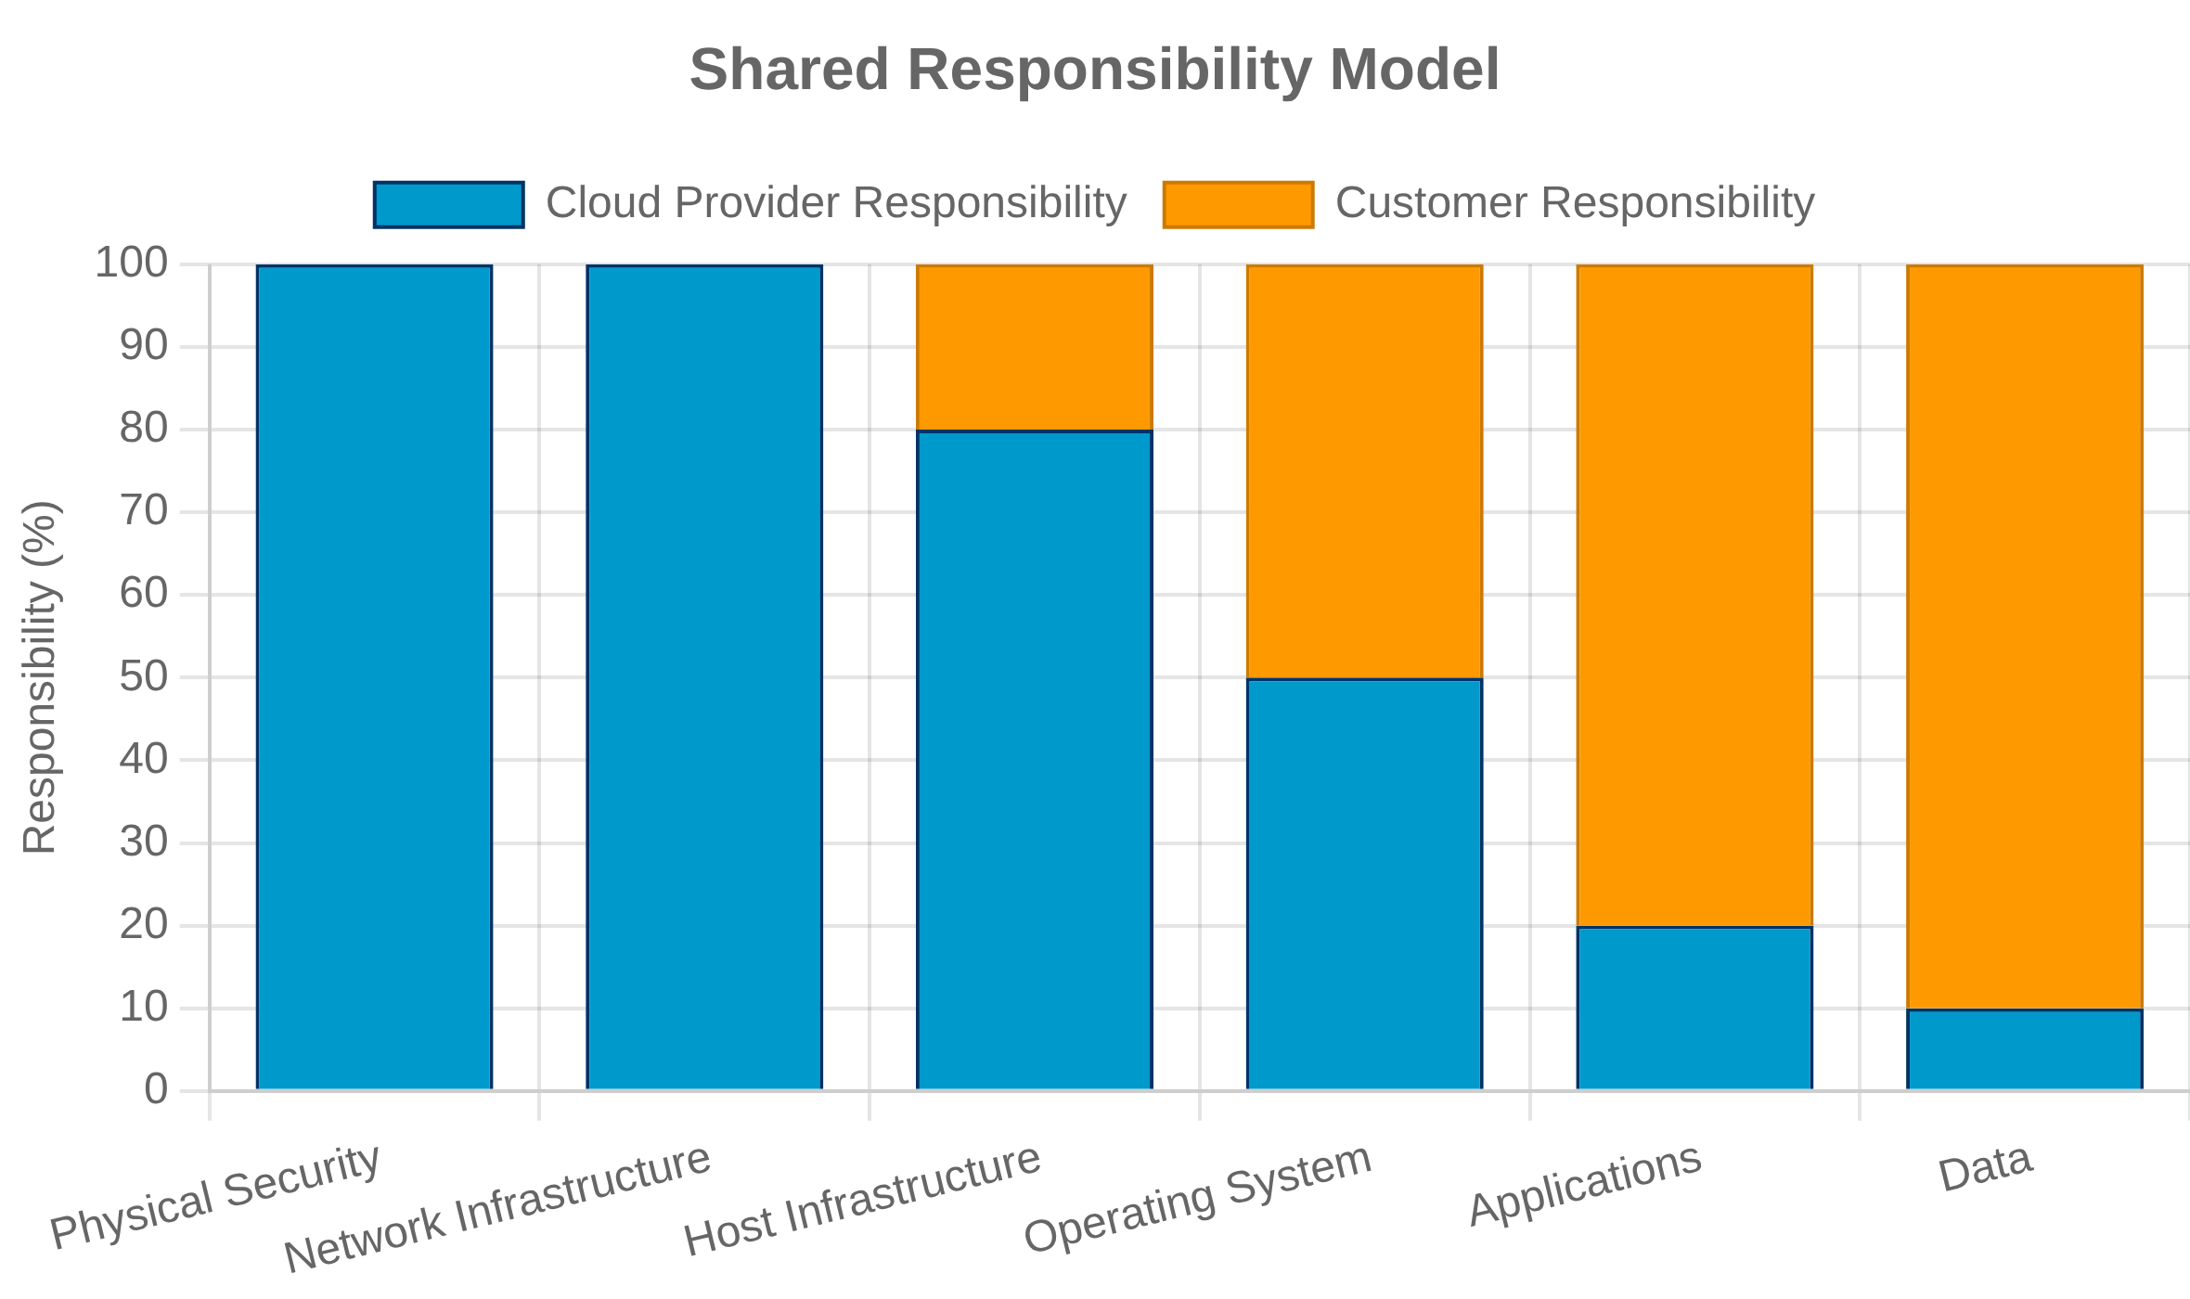


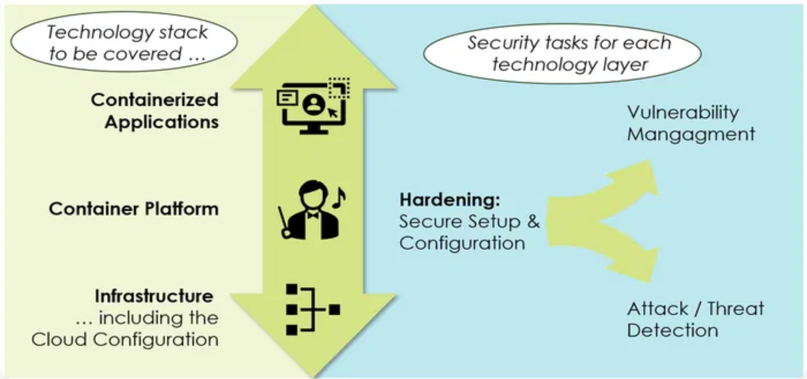

Security in Cloud Environments
Cloud Security Models
Infrastructure as a Service (IaaS)
Customer responsible for OS, middleware, applications, data, and their security.
Platform as a Service (PaaS)
Customer responsible for applications and data security; provider handles infrastructure.
Software as a Service (SaaS)
Customer primarily responsible for data and access management; provider handles most security aspects.
Common Cloud Vulnerabilities
Misconfigured access controls and security groups
Insecure APIs and weak authentication mechanisms
20

Slide 21

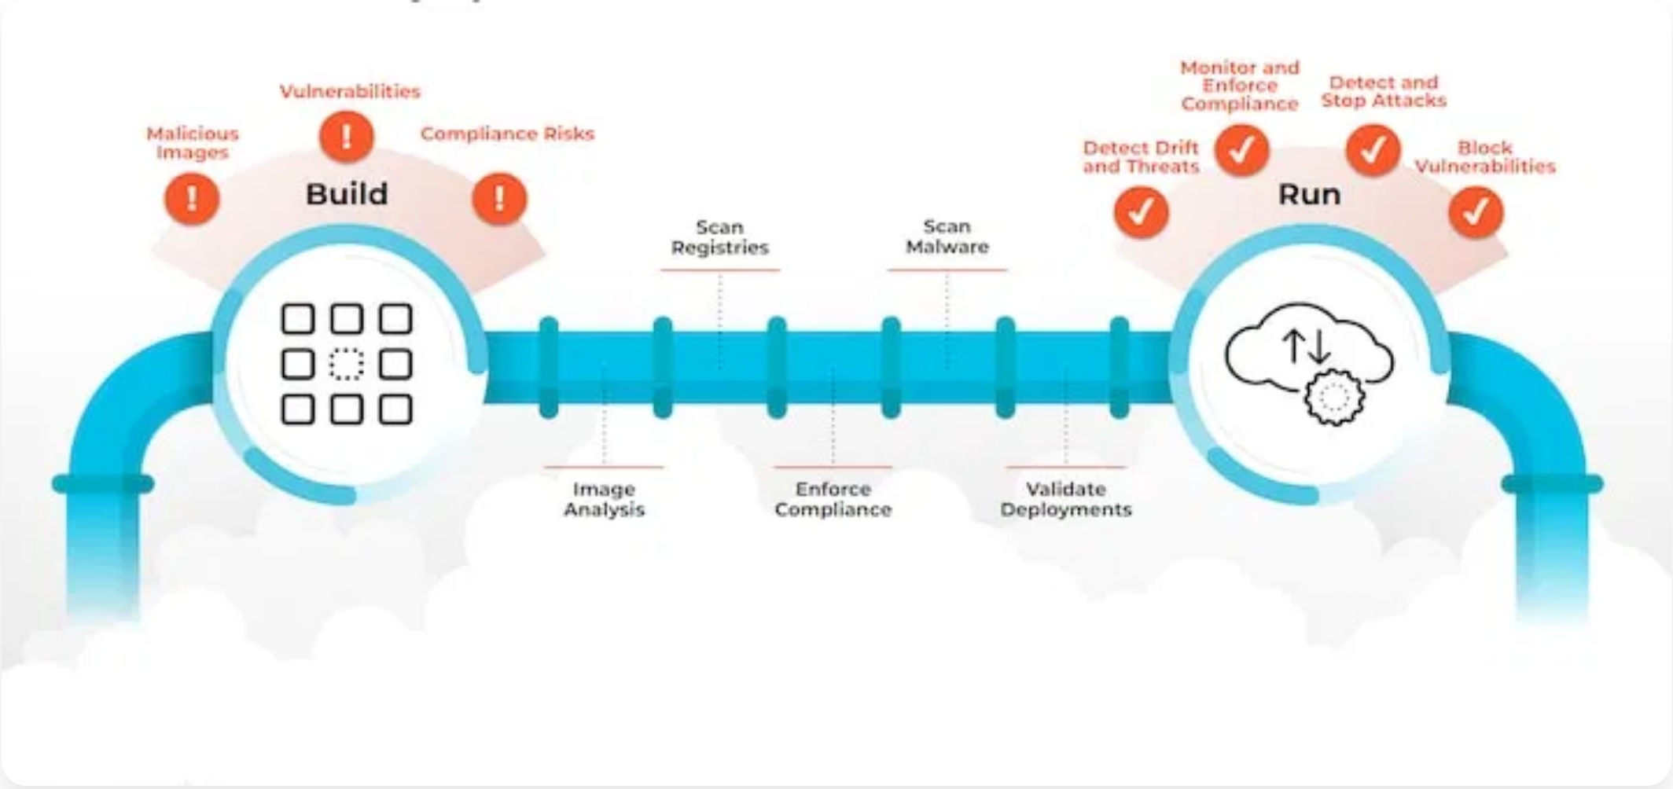


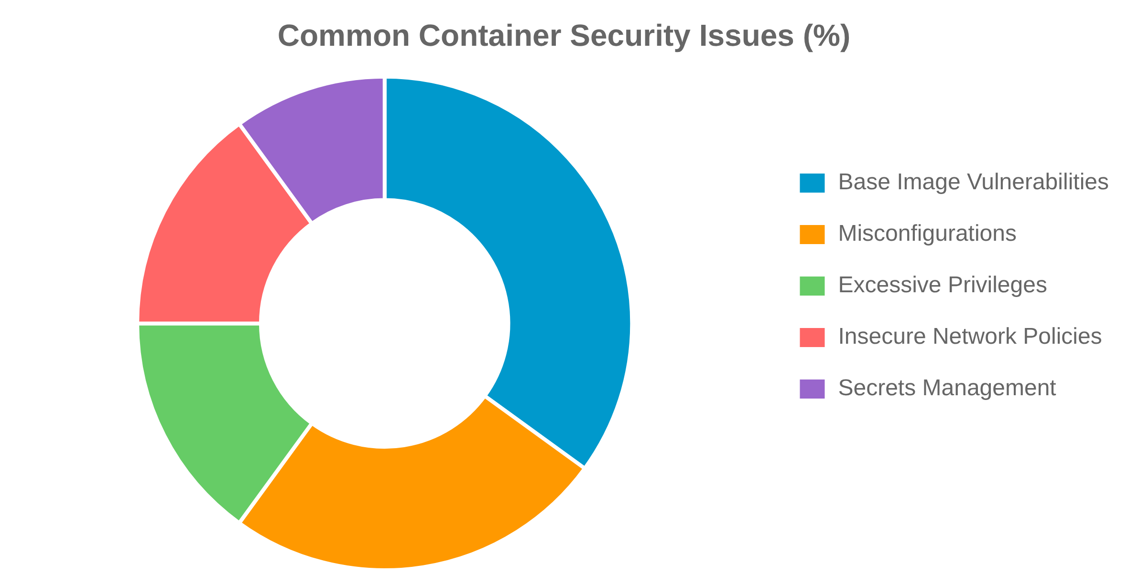


Container Security
Containerization
Containers package application code, dependencies, and
runtime into isolated units.
Security Challenges
Container Image Scanning
: Detect vulnerabilities in base images and
dependencies before deployment.
Runtime Security
: Monitor container behavior, enforce policies, and
detect anomalies during execution.
Access Control
: Implement least privilege principles for container
access and orchestration platforms.
Network Segmentation
: Isolate container networks and implement
proper ingress/egress controls.
21

Slide 22
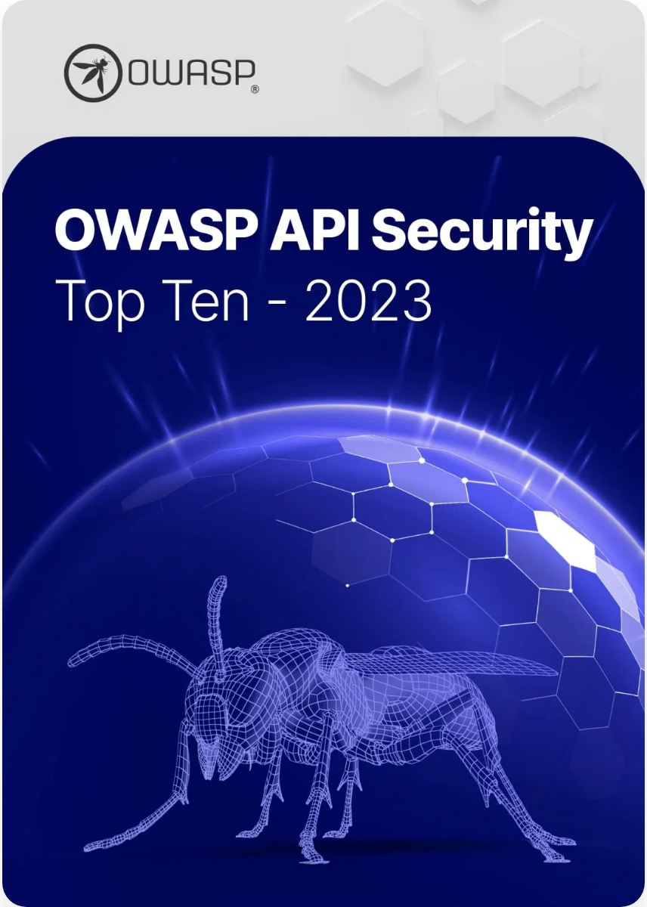


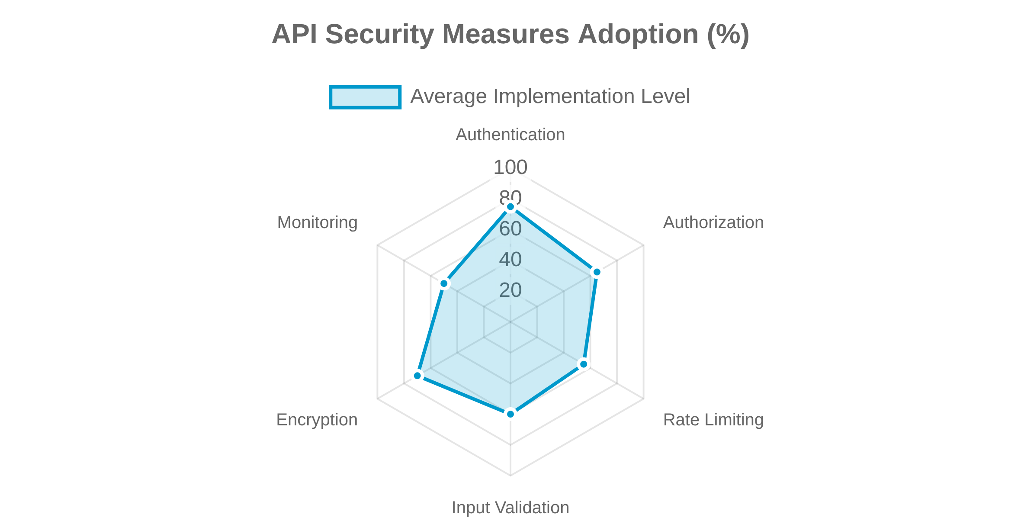

API Security
Common API Vulnerabilities (OWASP API Security Top 10)
API1: Broken Object Level Authorization
APIs often expose endpoints that handle object identifiers, creating a wide attack surface for object level access control issues.
API2: Broken Authentication
Authentication mechanisms are often implemented incorrectly, allowing attackers to compromise tokens or exploit implementation flaws.
Authentication & Authorization for APIs
Use industry standards: OAuth 2.0, OpenID Connect, JWT
Implement proper token validation and expiration
22

Slide 23
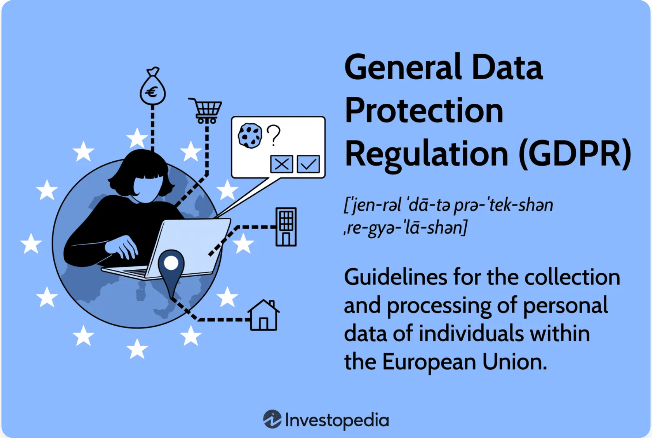




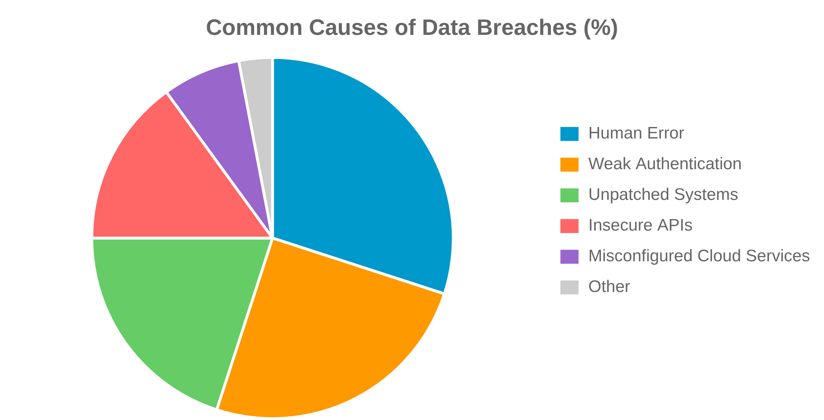

Data Privacy and Protection
Regulatory Landscape
GDPR (General Data Protection Regulation)
: EU regulation on data
protection and privacy, with strict requirements for consent and data
subject rights.
CCPA/CPRA (California Consumer Privacy Act)
: Gives California
residents rights over their personal information.
HIPAA (Health Insurance Portability and Accountability Act)
:
Protects sensitive patient health information in the US.
Data Protection Techniques
Encryption
: Protecting data at rest and in transit using strong
encryption algorithms.
Data Masking
: Hiding sensitive data with modified content while
maintaining format.
23

Slide 24

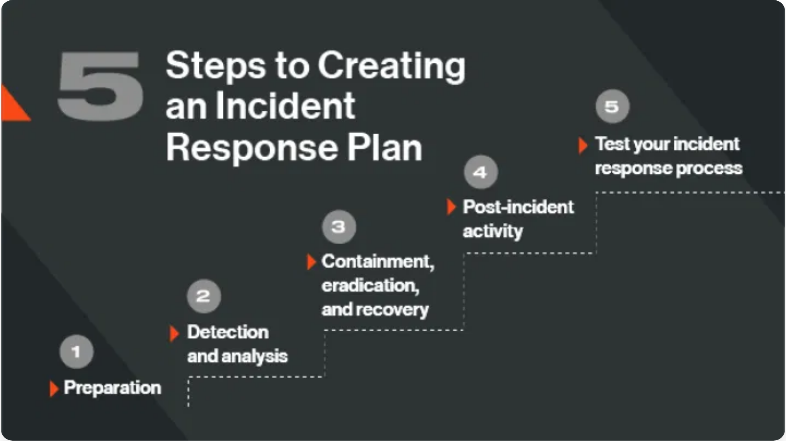
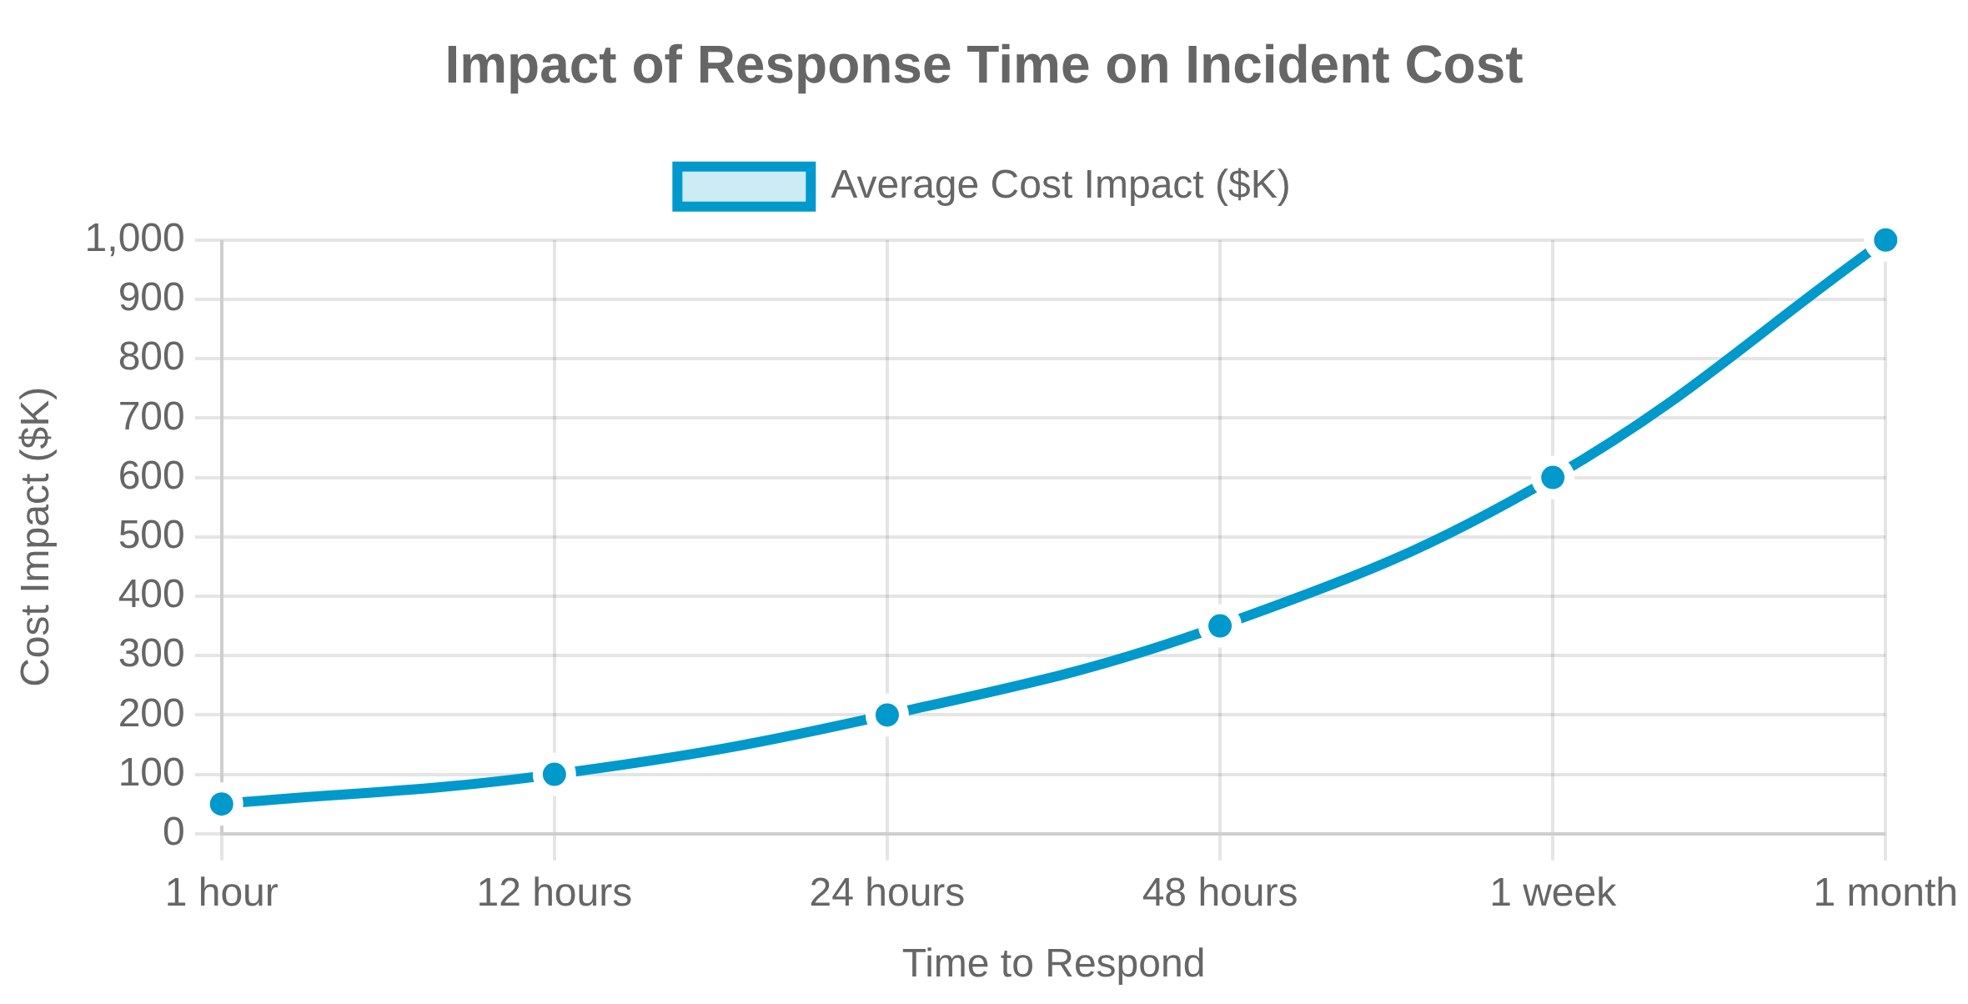
Incident Response Planning
Importance of a Well-Defined IR Plan
A structured approach to address and manage the
aftermath of security breaches or attacks.
Phases of Incident Response
Preparation
1
Develop policies, response procedures, and communication strategies.
Identification
2
Detect and determine whether an incident has occurred and its scope.
3
Containment
Limit the damage and prevent further damage from occurring.
4
Eradication & Recovery
Remove the threat and restore systems to normal operation.
5
Post-Incident Analysis
Document lessons learned and improve future response.
24

Slide 25
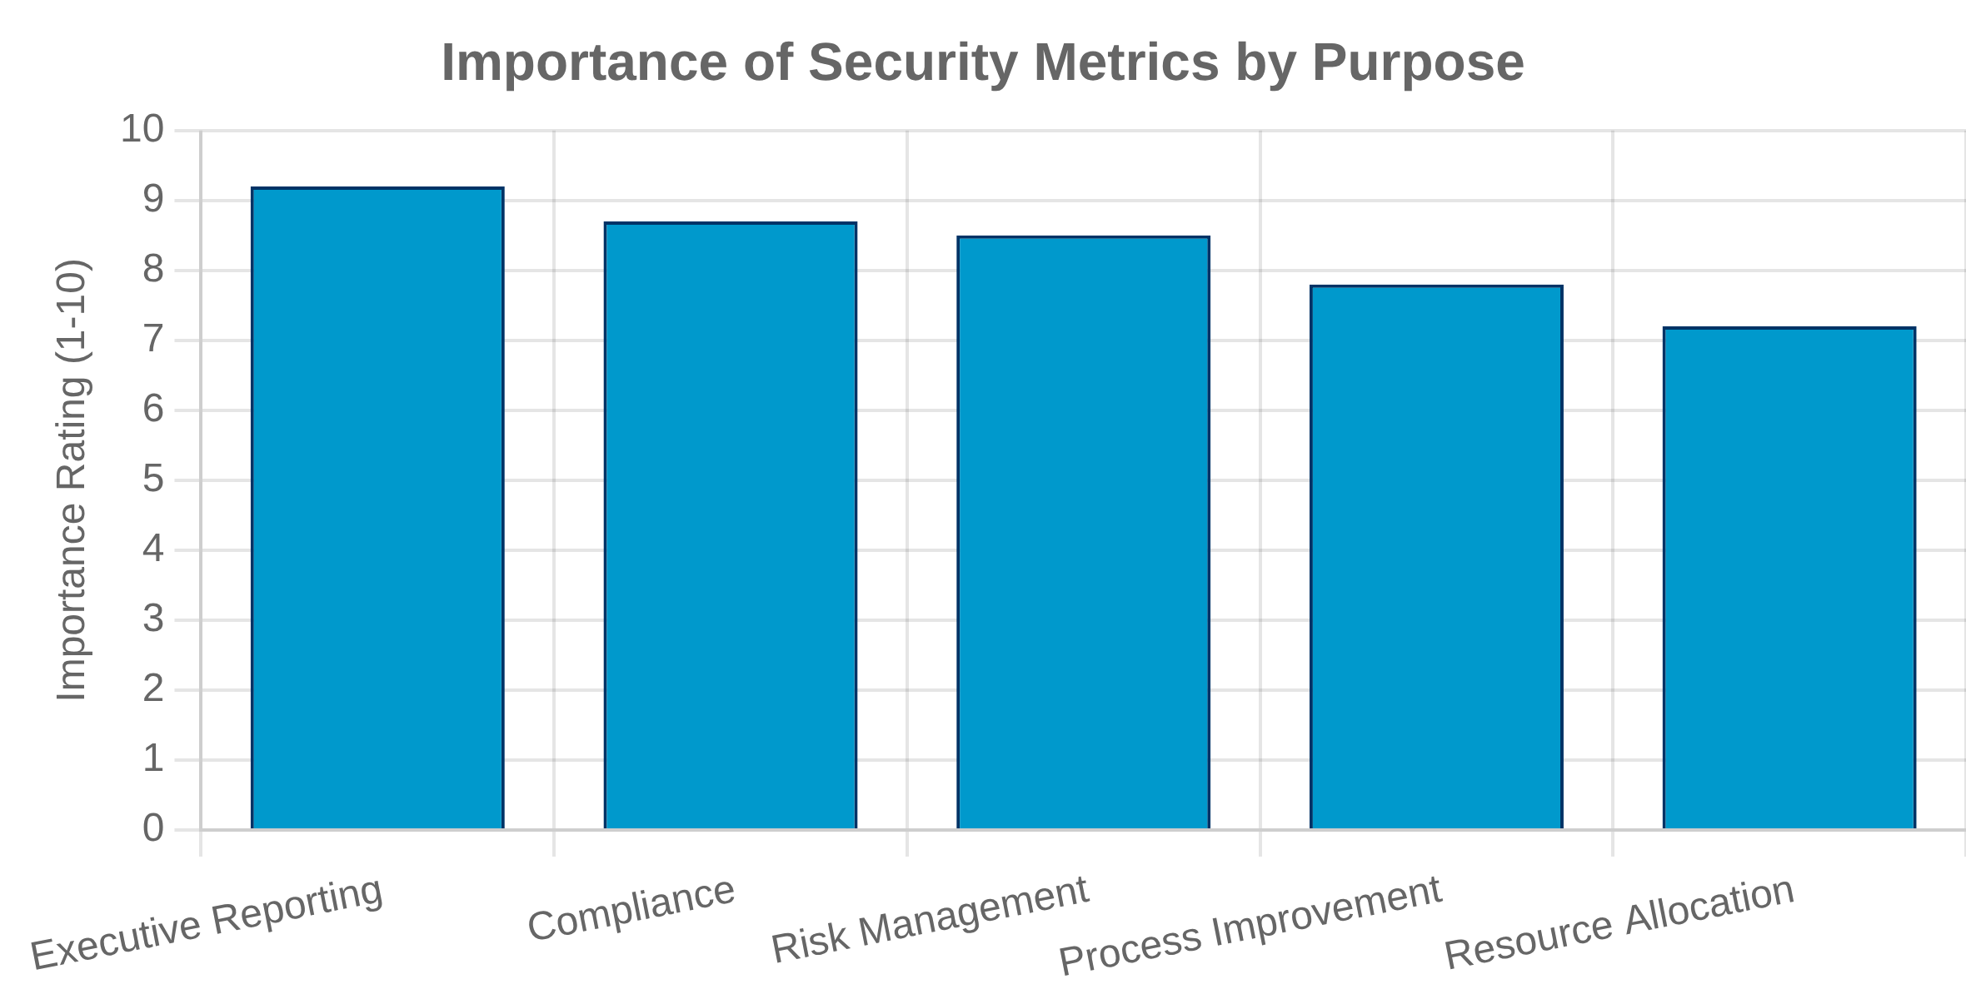



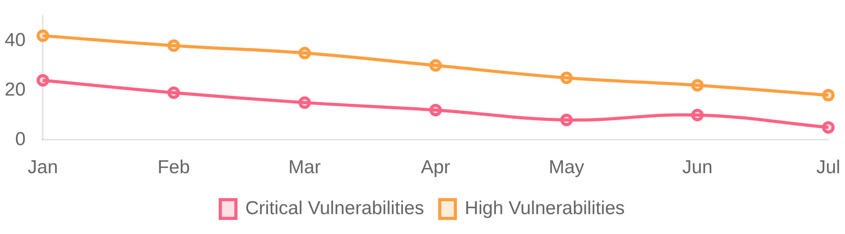
Security Metrics and Reporting
Key Security Performance Indicators (KPIs)
Vulnerability Management Metrics
Mean Time to Remediate
Vulnerability Density
Patch Coverage
Secure Development Metrics
Security Debt Ratio
Security Test Coverage
Security Requirements Coverage
Incident Response Metrics
Security Dashboard Example
July 2025
Mean Time to Detect
Mean Time to Respond
Incident Rate
94%
2.3d
12
Reporting to Stakeholders
Vulnerability Remediation Rate
Mean Time to Remediate (Critical)
Open Security Findings
Tailor reports to different audiences (executives, technical
teams, compliance)
Focus on trends and improvements rather than just point-
in-time data
25

Slide 26

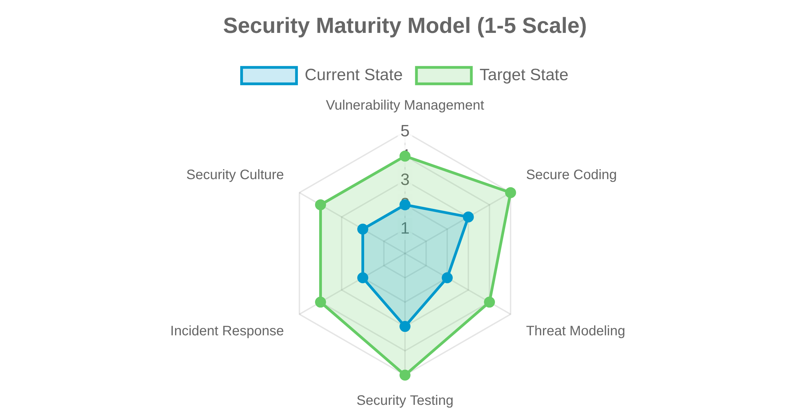









Continuous Security Improvement
Feedback Loops in SSDLC
Continuous integration of security findings and lessons
learned back into the development process.
Automation in Security Processes
Automated Security Testing
: Integrate security testing into CI/CD
pipelines for early and consistent detection.
Policy as Code
: Define security policies as code to enable automated
enforcement and compliance checking.
Fostering a Security-Aware Culture
Security Champions
: Designate team members to advocate for
security practices and serve as a bridge between security and
development teams.
Plan
Continuous Learning
: Regular training, workshops, and knowledge
sharing to keep up with evolving threats and best practices.
Improve
Implement
Measure
26

Slide 27

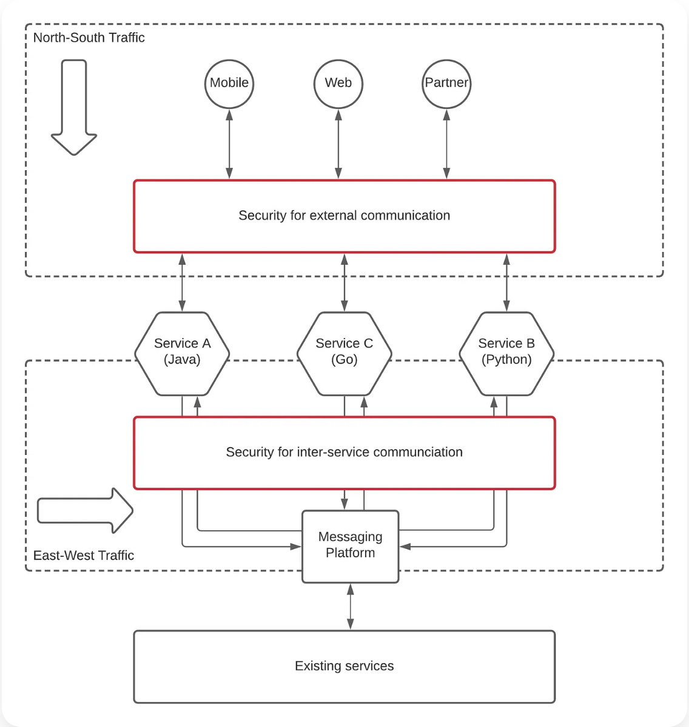







Software Supply Chain Security
What is Software Supply Chain Security?
Protecting the integrity of software components and
dependencies throughout the development lifecycle.
Common Supply Chain Risks
Compromised Dependencies
: Malicious code injected into third-party
libraries or packages.
Build Tool Tampering
: Attacks targeting CI/CD pipelines and build
systems.
Code Signing Attacks
: Compromised signing keys or certificates used
to distribute malicious software.
Best Practices
Software Bill of Materials (SBOM)
: Maintain a comprehensive
inventory of all components and dependencies.
Trusted Registries
: Use verified and secure package repositories with
integrity verification.
Secure CI/CD Pipelines
: Implement security controls in build and
deployment processes.
27

Slide 28
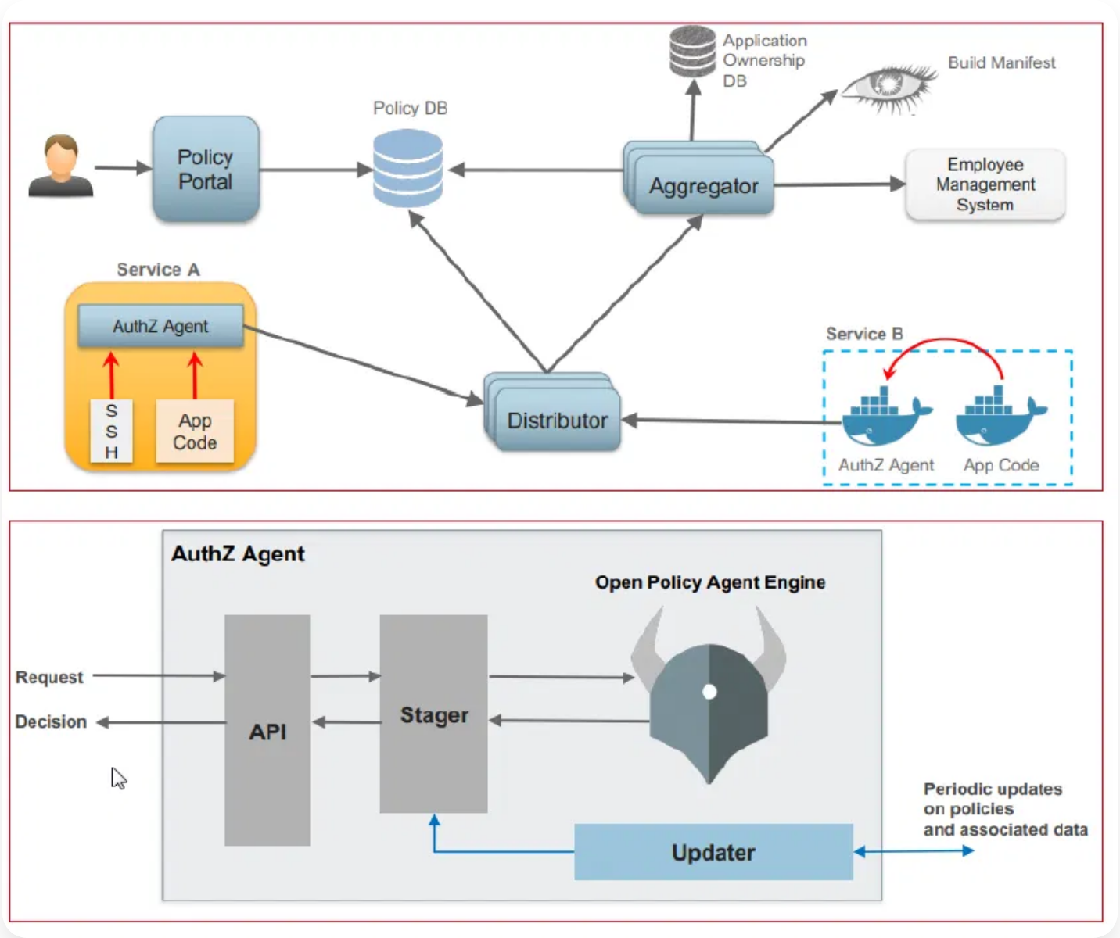










Open Source Software Security
Benefits vs. Risks
Benefits
Risks
Transparency and code visibility
Unpatched vulnerabilities
Dependency chain complexity
Community-driven security reviews
Malicious package insertion
Faster development cycles
Lack of security expertise
Cost-effective solutions
Vulnerability Management
Security Tools for Open Source
Establish a process for identifying, assessing, and
Software Composition Analysis (SCA)
: Automatically identify and track
remediating vulnerabilities in open-source components.
open-source components and their vulnerabilities.
Dependency Locking
: Pin dependencies to specific verified versions to
prevent unexpected updates.
Vulnerability Scanners
: Regularly scan codebases for known
vulnerabilities in open-source components.
28

Slide 29

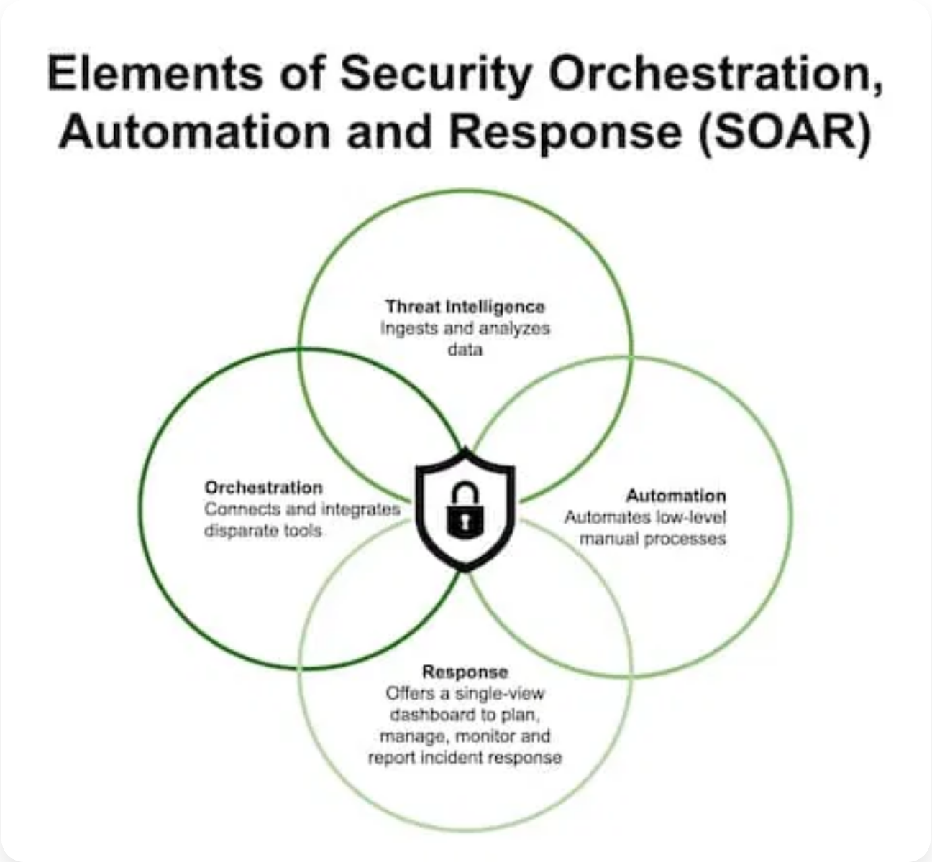





Secure Configuration Management
What is Secure Configuration Management?
The process of establishing and maintaining consistent
security settings across systems, services, and applications.
Secure Configuration Process
1
Baseline Establishment
Define secure configuration baselines based on industry standards (CIS, NIST, DISA STIGs).
2
Implementation
Apply secure configurations to systems and applications through automation.
Common Security Misconfigurations
3
Monitoring & Drift Detection
Continuously monitor for unauthorized changes to configurations.
Default credentials or weak password policies
4
Remediation
Excessive permissions and privileges
Correct deviations from approved configurations automatically or through controlled processes.
Disabled security features and controls
Unnecessary open ports and services
29

Slide 30

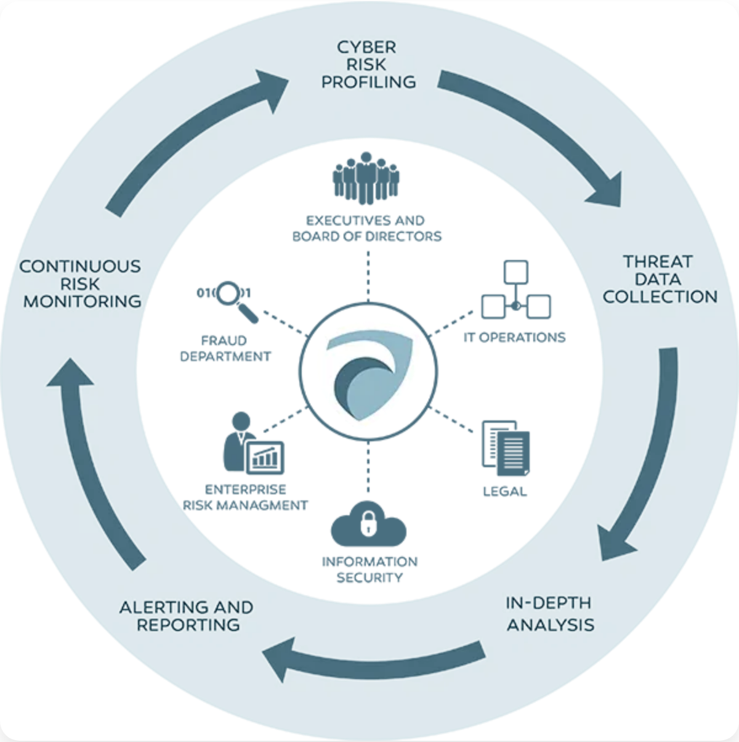










Security Automation and Orchestration (SOAR)
What is SOAR?
Security Orchestration, Automation, and Response (SOAR)
combines orchestration, automation, and incident response
capabilities to improve security operations efficiency.
Key Components
Orchestration
: Connects and coordinates different security tools and
systems to work together seamlessly.
Automation
: Executes predefined workflows and playbooks to handle
routine security tasks without human intervention.
Response
: Provides a structured approach to manage and resolve
Use Cases in SSDLC
security incidents efficiently.
Benefits in Secure Software Engineering
CI/CD Security
Vulnerability Management
Automated security testing and vulnerability scanning in CI/CD pipelines.
Automated prioritization and remediation of security vulnerabilities.
Accelerates detection and response to security threats
Reduces human error in security operations
Incident Response
Compliance Monitoring
Improves efficiency and scalability of security teams
Automated containment and remediation of security incidents.
Continuous monitoring and reporting of compliance status.
30

Slide 31

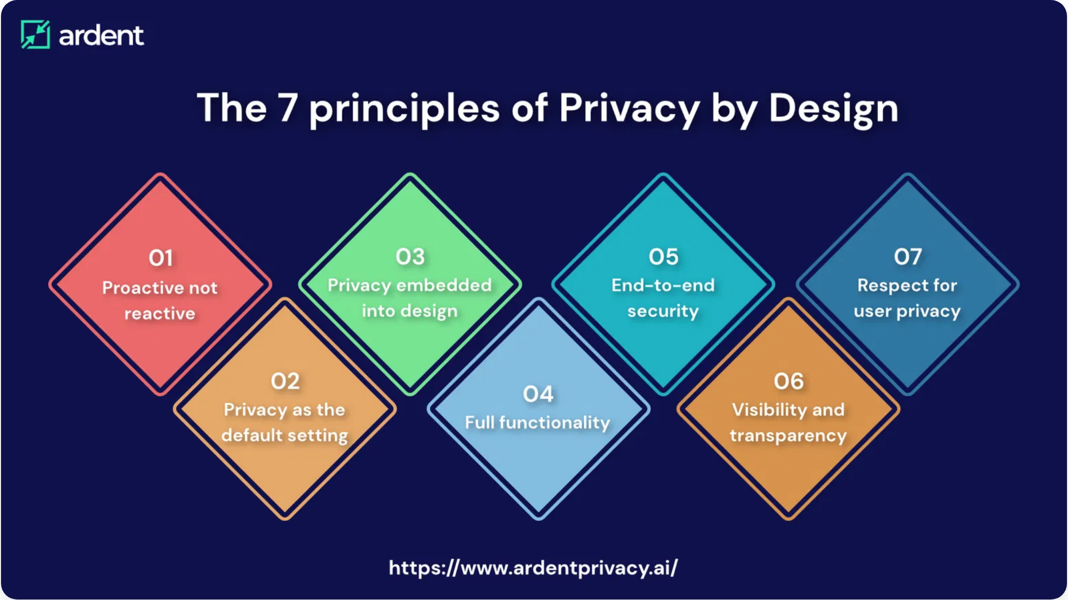












Threat Intelligence Integration
What is Threat Intelligence?
Evidence-based knowledge about existing or emerging
threats that can inform security decisions and help
organizations protect against attacks.
Sources of Threat Intelligence
Open Source Intelligence (OSINT)
: Publicly available information
from forums, blogs, and social media.
Commercial Feeds
: Paid services providing curated threat data and
analysis.
Integration Points in SSDLC
Information Sharing Communities
: Industry-specific groups sharing
threat information (ISACs, ISAOs).
Internal Security Tools
: Data from SIEM, EDR, and other security
Requirements Phase
: Inform security requirements based on current
systems.
threat landscape.
patterns and vectors.
Design Phase
: Enhance threat modeling with real-world attack
Implementation Phase
: Guide secure coding practices to address
known vulnerabilities.
Testing Phase
: Focus security testing on relevant threats and attack
scenarios.
Collection
Processing
Analysis
Dissemination
Feedback
31

Slide 32

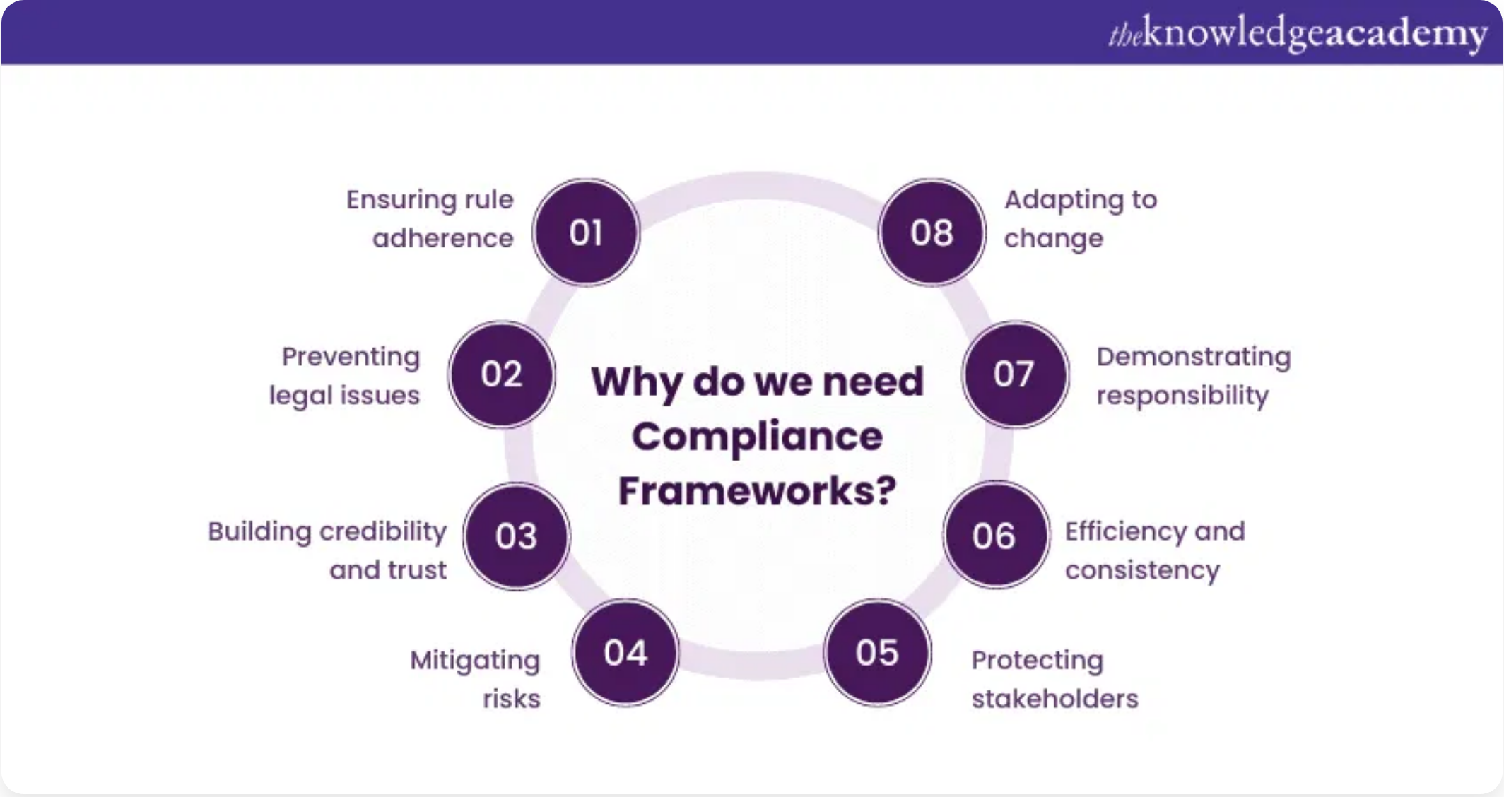


Privacy by Design and Default
What is Privacy by Design?
An approach that integrates privacy protection into
systems, processes, and products from the earliest design
stages rather than adding it later.
7 Foundational Principles
1
Proactive not Reactive
Anticipate and prevent privacy issues before they occur.
2
Privacy as the Default
Ensure personal data is automatically protected without user action.
5
End-to-End Security
3
Privacy Embedded into Design
Ensure full lifecycle protection of data from collection to deletion.
Build privacy into the architecture and not as an add-on.
6
Visibility and Transparency
4
Full Functionality
Keep operations open and accountable to users and stakeholders.
Avoid false trade-offs between privacy and security or functionality.
7
Respect for User Privacy
Keep the user's interests central with strong privacy defaults and controls.
Implementation in SSDLC
Data Minimization
: Collect only what's necessary for the specific
purpose.
Privacy Controls
: Build user-friendly privacy settings and controls.
32

Slide 33
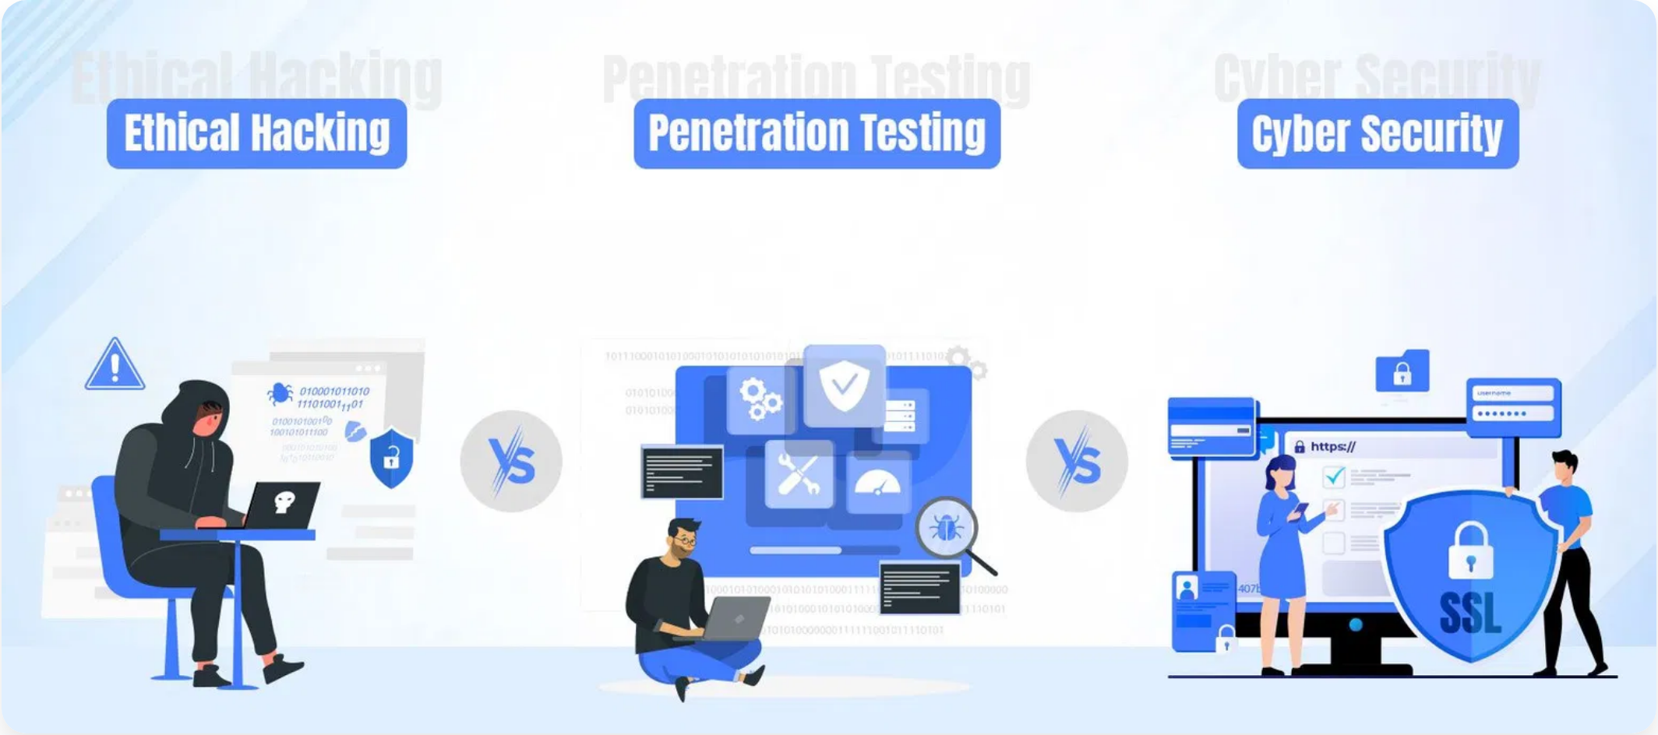








Legal and Regulatory Compliance
Key Regulations and Standards
GDPR (General Data Protection Regulation)
EU regulation on data protection and privacy, requiring data protection by design and default.
CCPA/CPRA (California Consumer Privacy Act)
Gives California residents rights over their personal information and how businesses handle it.
Impact on Software Development
HIPAA (Health Insurance Portability and Accountability Act)
Security Requirements
: Regulations often mandate specific security
U.S. regulation for protecting sensitive patient health information.
controls and practices.
PCI DSS (Payment Card Industry Data Security Standard)
Data Handling
: Requirements for data collection, storage, processing,
and deletion.
Security standard for organizations that handle credit card information.
User Rights
: Need to implement features supporting user rights
(access, deletion, portability).
Documentation
: Requirements for maintaining evidence of compliance
and security measures.
Breach Notification
: Procedures for detecting, reporting, and
responding to data breaches.
33

Slide 34

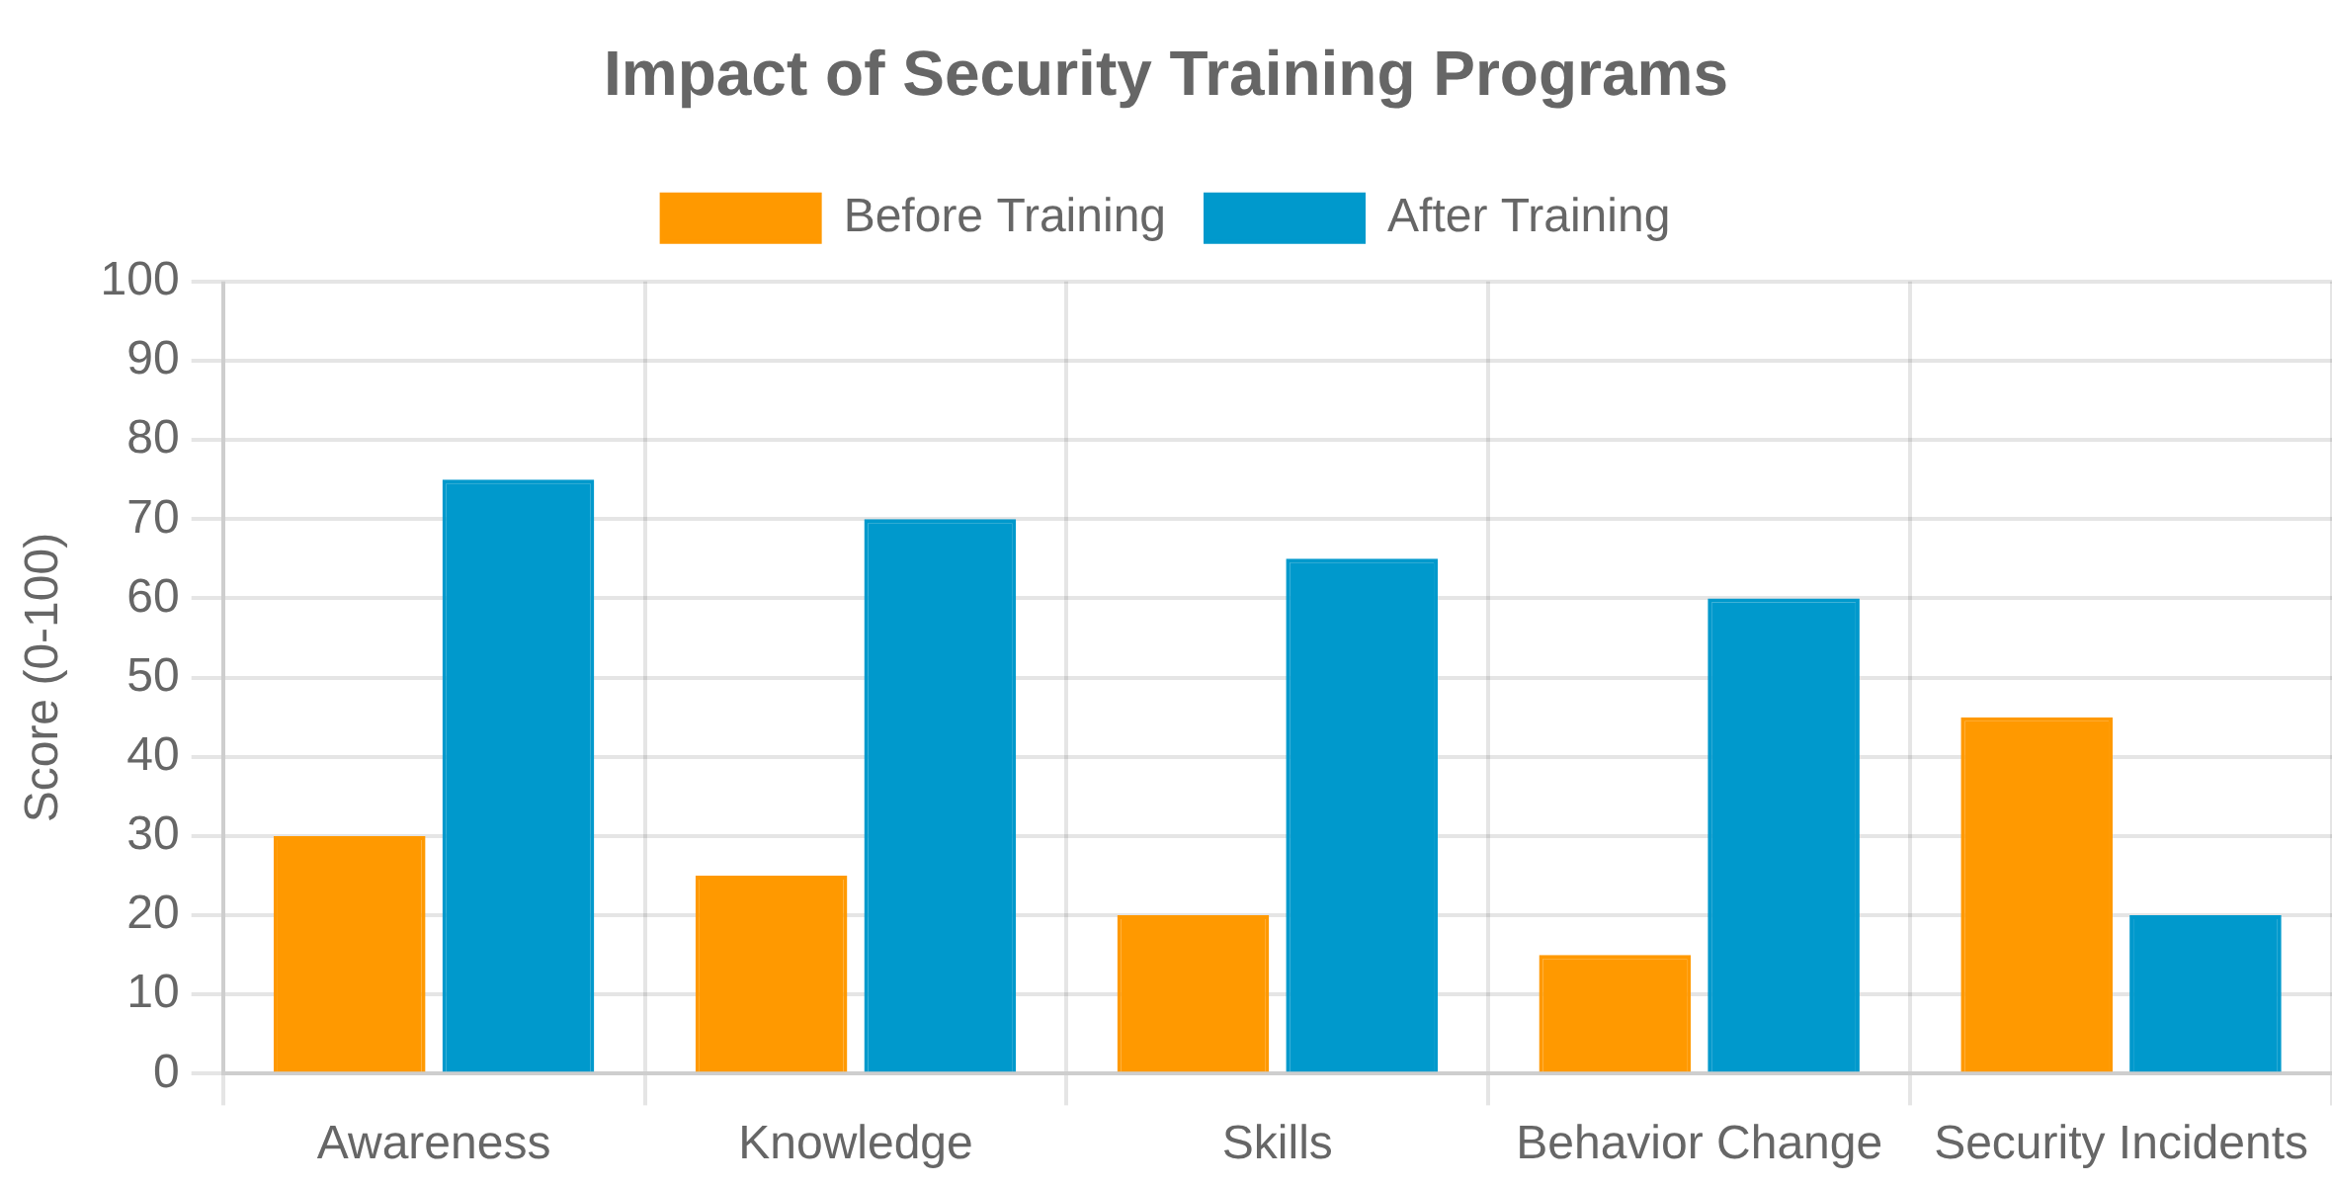








Security Training and Awareness
Importance of Security Training
Developers and other stakeholders are often the first line
of defense against security threats. Proper training helps build
a security-first mindset throughout the organization.
Types of Security Training
Secure Coding Practices
Training on writing code that is resistant to common vulnerabilities and attacks.
Threat Modeling
Teaching teams how to identify, analyze, and mitigate potential security threats.
Best Practices for Security Training
Security Tools and Technologies
Continuous Learning
: Security training should be ongoing, not a one-
time event, to keep up with evolving threats.
Hands-on training with security testing tools, SAST, DAST, and other security technologies.
Incident Response
Hands-on Exercises
: Include practical exercises and real-world scenarios
for better retention.
Preparing teams to recognize and respond to security incidents effectively.
Role-Specific Training
: Tailor training content to specific roles and
responsibilities within the team.
Gamification
: Use challenges, competitions, and rewards to increase
engagement and motivation.
Measure Effectiveness
: Regularly assess the impact of training on
security practices and outcomes.
34

Slide 35

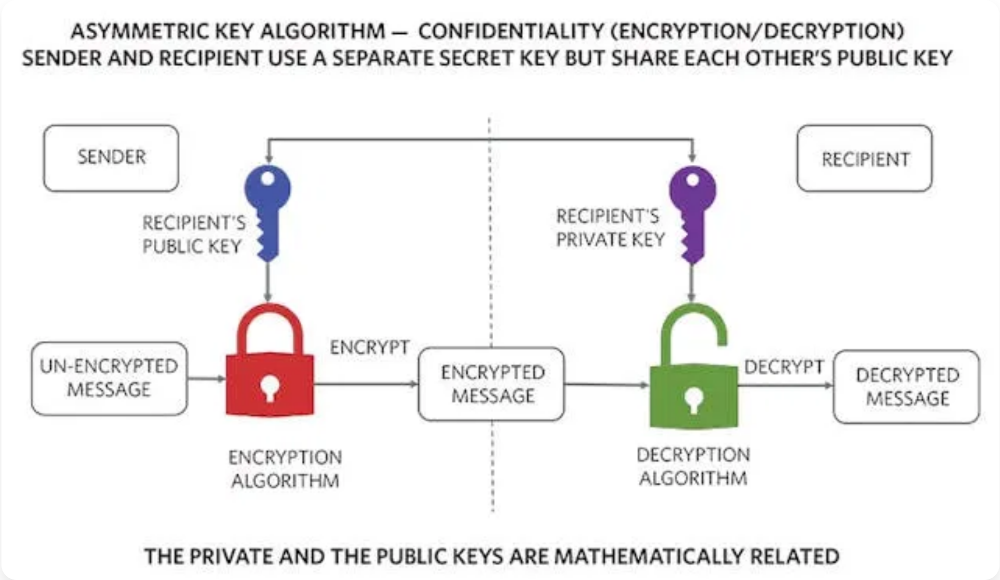




Ethical Hacking and Penetration Testing
What is Ethical Hacking?
The practice of legally and methodically attempting to
penetrate systems and applications to find and fix security
vulnerabilities before malicious hackers can exploit them.
Types of Penetration Tests
Black Box Testing
Tester has no prior knowledge of the system, simulating an external attacker.
Penetration Testing Methodology
White Box Testing
Tester has complete knowledge of the system, including source code and architecture.
1
2
3
4
5
Gray Box Testing
Planning
Reconnaissance
Scanning
Exploitation
Reporting
Tester has partial knowledge of the system, simulating an insider or privileged user.
Benefits in SSDLC
Benefit
Impact
Vulnerability Discovery
Identifies security weaknesses before production
Risk Assessment
Provides realistic evaluation of security posture
Compliance Validation
Helps meet regulatory requirements
Security Awareness
Improves team understanding of attack vectors
35

Slide 36

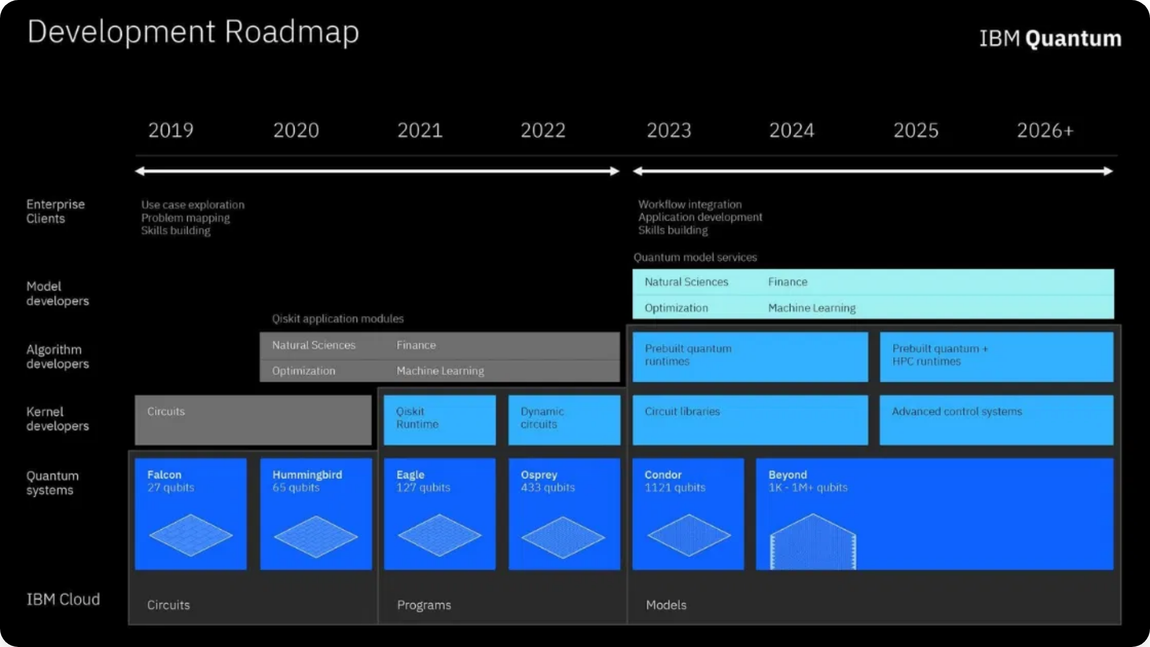





Cryptography Fundamentals for SSE
Core Cryptographic Concepts
Symmetric Encryption
Uses the same key for encryption and decryption. Fast but requires secure key exchange.
Asymmetric Encryption
Uses public-private key pairs. Slower but solves key distribution problem.
Hashing
One-way function that creates a fixed-size output from variable-size input.
Comparison of Encryption Types
Digital Signatures
Combines asymmetric encryption and hashing for authentication.
Feature
Symmetric
Asymmetric
Speed
Fast
Slow
Key Management
Complex
Simpler
Security
High
Very High
Key Management Best Practices
Strong Key Generation
: Use cryptographically secure random number
generators.
Secure Storage
: Never hardcode keys in source code; use secure key
vaults.
36

Slide 37

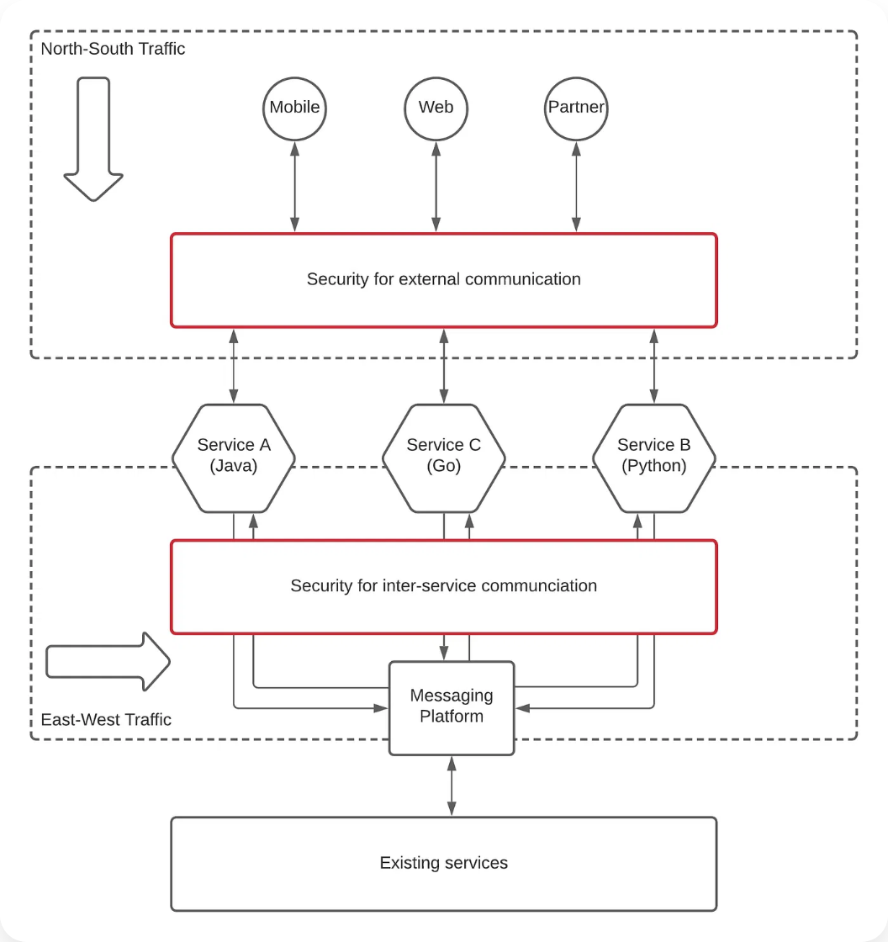






Secure Microservices Architecture
Security Challenges in Microservices
Increased Attack Surface
More services and communication paths create more potential entry points.
Authentication & Authorization
Managing identity across distributed services is complex.
Service-to-Service Communication
Securing inter-service communication requires careful design.
Data Security
Distributed data storage increases complexity of data protection.
Security Best Practices
Defense in Depth
: Implement security at multiple layers (network, API,
service).
Centralized Identity Management
: Use OAuth/OIDC for consistent
authentication.
API Gateway Security
: Implement rate limiting, validation, and
authentication at the gateway.
Least Privilege
: Each service should have minimal required
permissions.
Service Mesh
: Use service mesh for secure service-to-service
communication.
37

Slide 38





Quantum Computing Impact on Security
The Quantum Threat
Quantum computers could break many current
cryptographic algorithms, particularly those based on
factoring large numbers and discrete logarithms.
Post-Quantum Cryptography
Vulnerable Cryptographic Systems
Lattice-based Cryptography
Algorithm
Quantum Vulnerability
Based on the difficulty of solving certain lattice problems.
RSA
Highly vulnerable (Shor's algorithm)
Hash-based Signatures
Based on the security of cryptographic hash functions.
ECC
Highly vulnerable (Shor's algorithm)
Preparing for Quantum Era
AES
Moderately vulnerable (Grover's algorithm)
SHA-2/SHA-3
Moderately vulnerable (Grover's algorithm)
Crypto Inventory
: Identify all cryptographic assets and algorithms in
use.
Timeline Considerations
Crypto Agility
: Design systems to easily swap cryptographic
algorithms.
While large-scale quantum computers may be years away,
organizations should prepare now for "harvest now, decrypt
later" attacks.
38

